Slide 1
Robotic Exploration of the Solar System by Group 1
Authors:
Rita da Cruz Fardilha
Iván Sermanoukian Molina
Yi Qiang Ji Zhang
Èric Montserrat Robles

Slide 2
Table of Contents
A2 - Spice Assignment
A3 - Image Processing Assignment
A4 - Remote Sensing of Earth Assignment
Remote Sensing of Earth Project
False color images and analysis; Temperature plot for a specific pixel
Spice Project
Compare latitude and longitude ranges to different time steps, blue area with the image processing thing, wind velocity estimation

Slide 3
New Horizons flyby across Jupiter and Pluto encounter
A2 - Spice Assignment

Slide 4
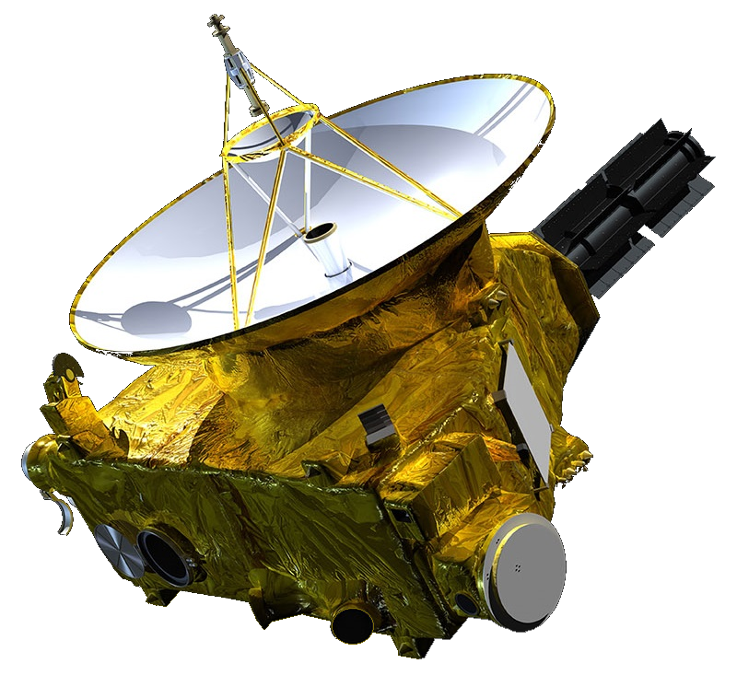
New Horizons
What is New Horizons?
NASA's New Horizons spacecraft is the first spacecraft to explore Pluto up close, flying by the dwarf planet and its moons on July 14, 2015. In early 2019, New Horizons flew past its second major science target—2014 MU69, the most distant object ever explored up close.

Slide 5
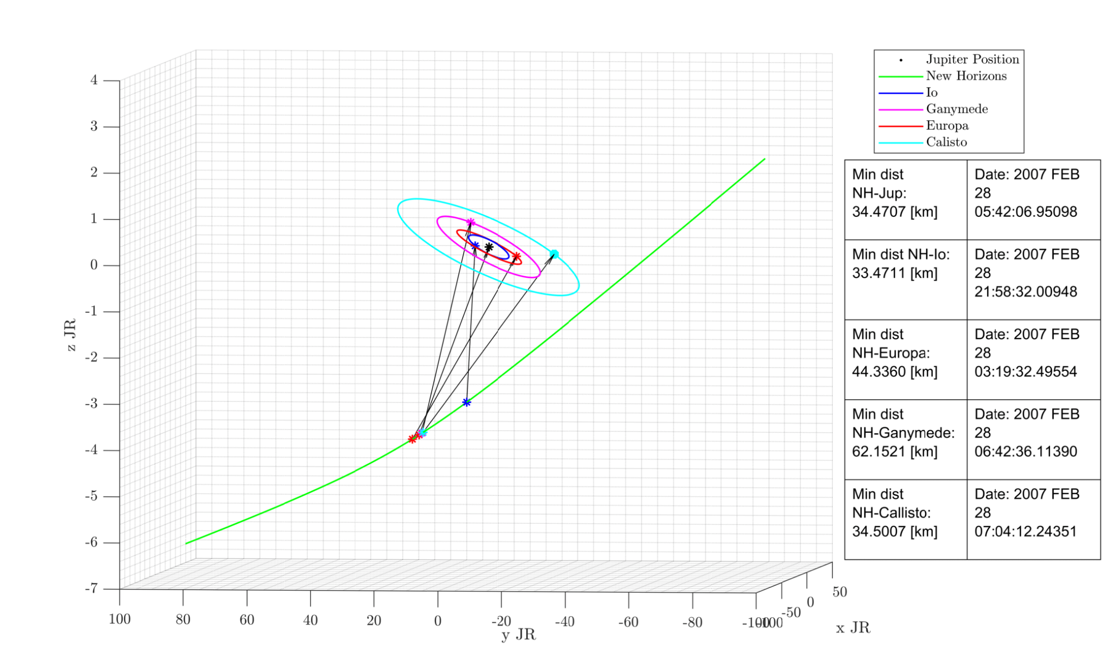
New Horizons flyby across Jupiter

Slide 6
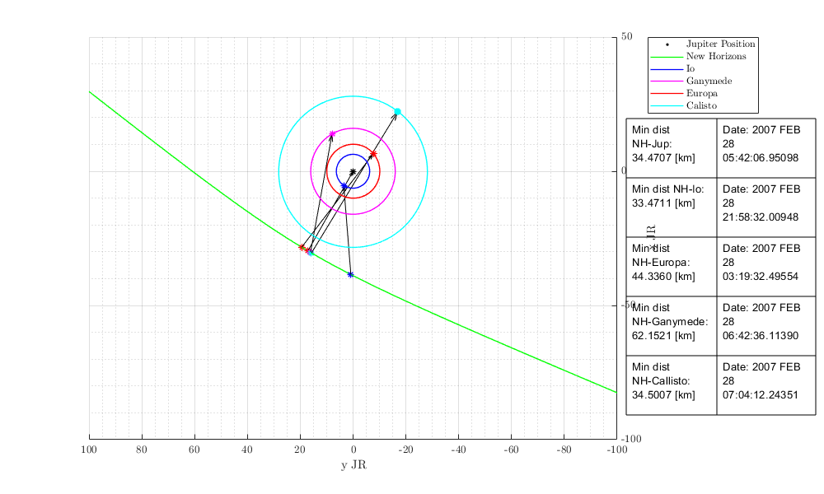
New Horizons flyby across Jupiter

Slide 7
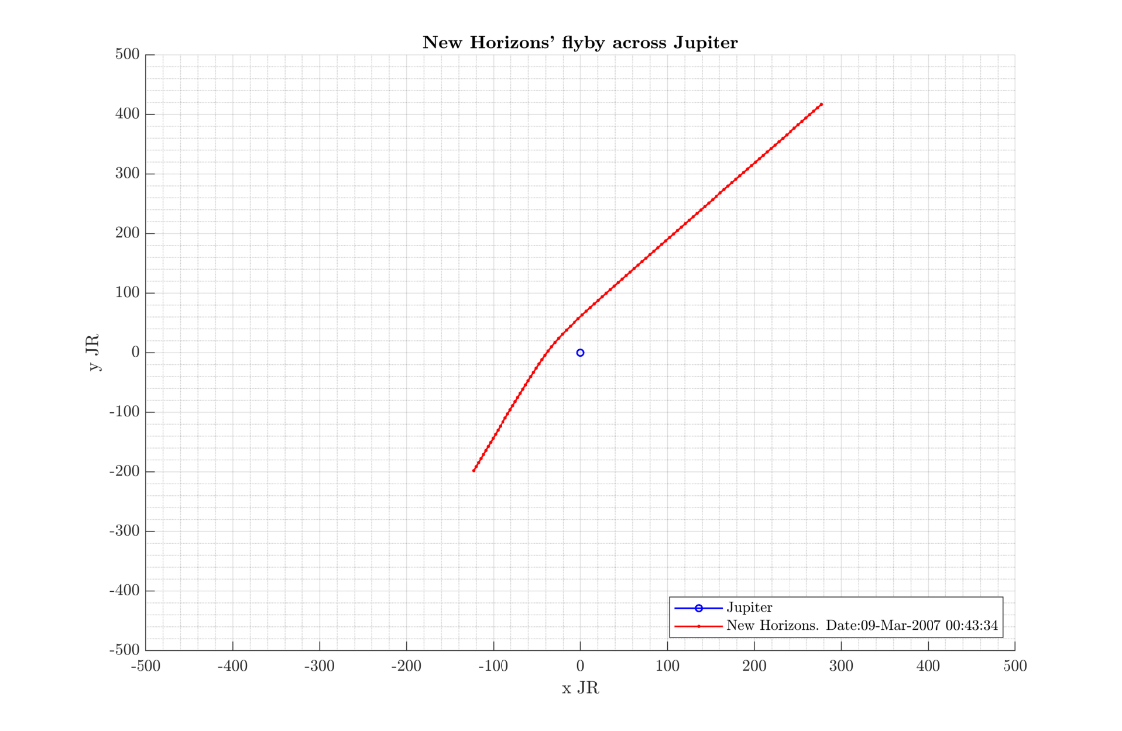

Slide 8
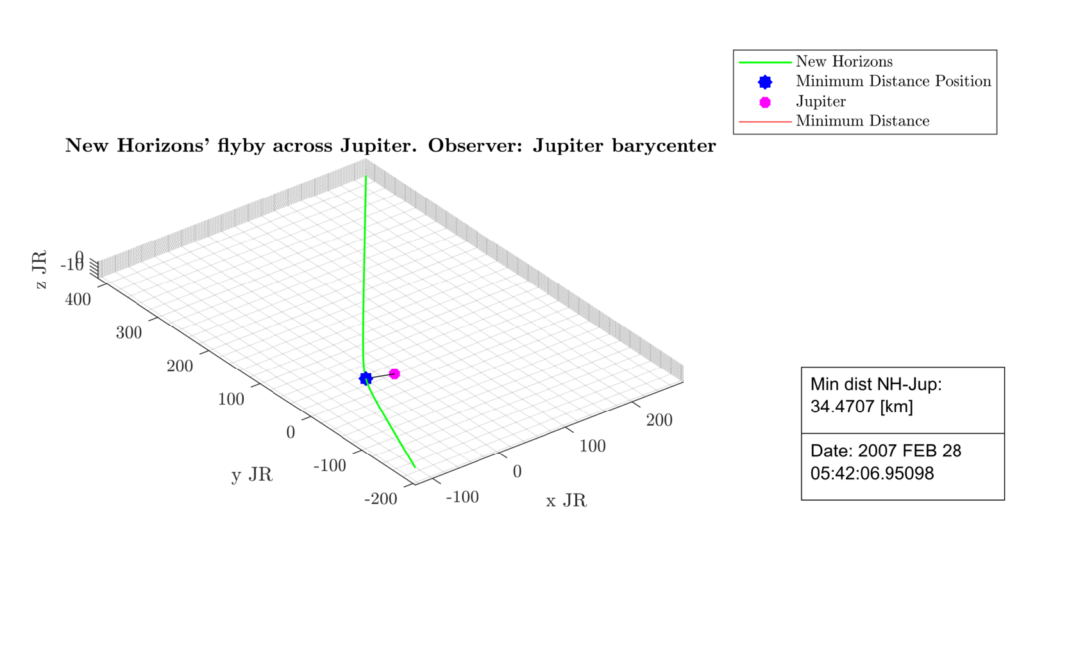

Slide 9
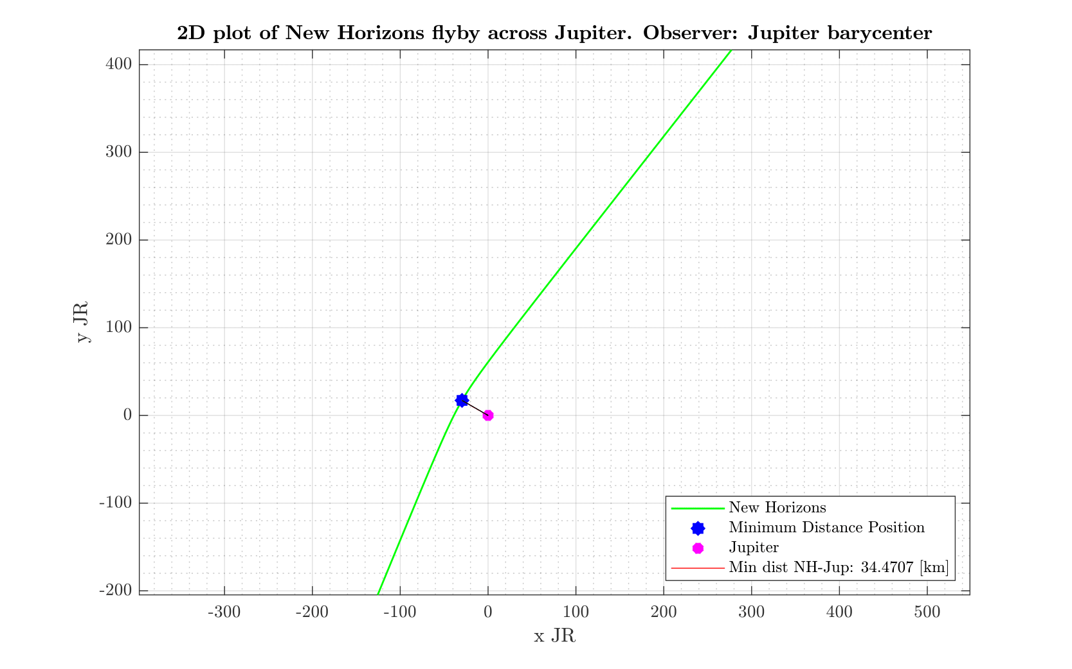

Slide 10
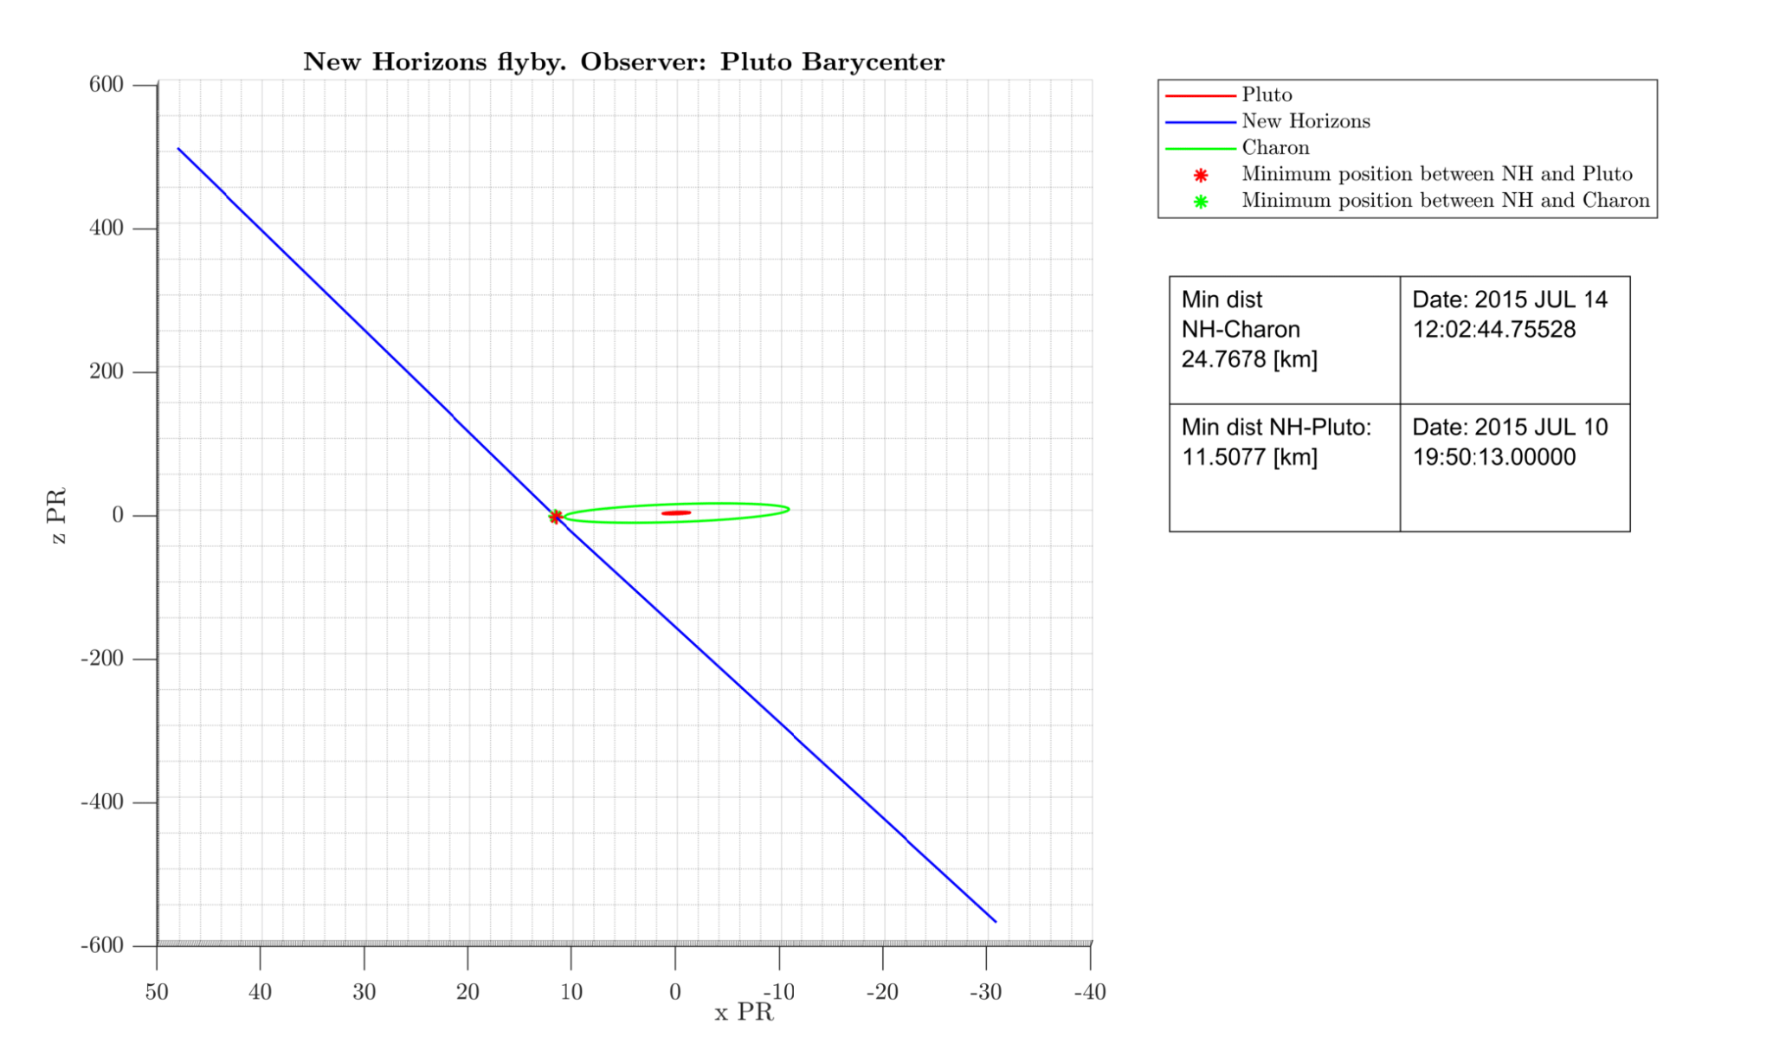

Slide 11
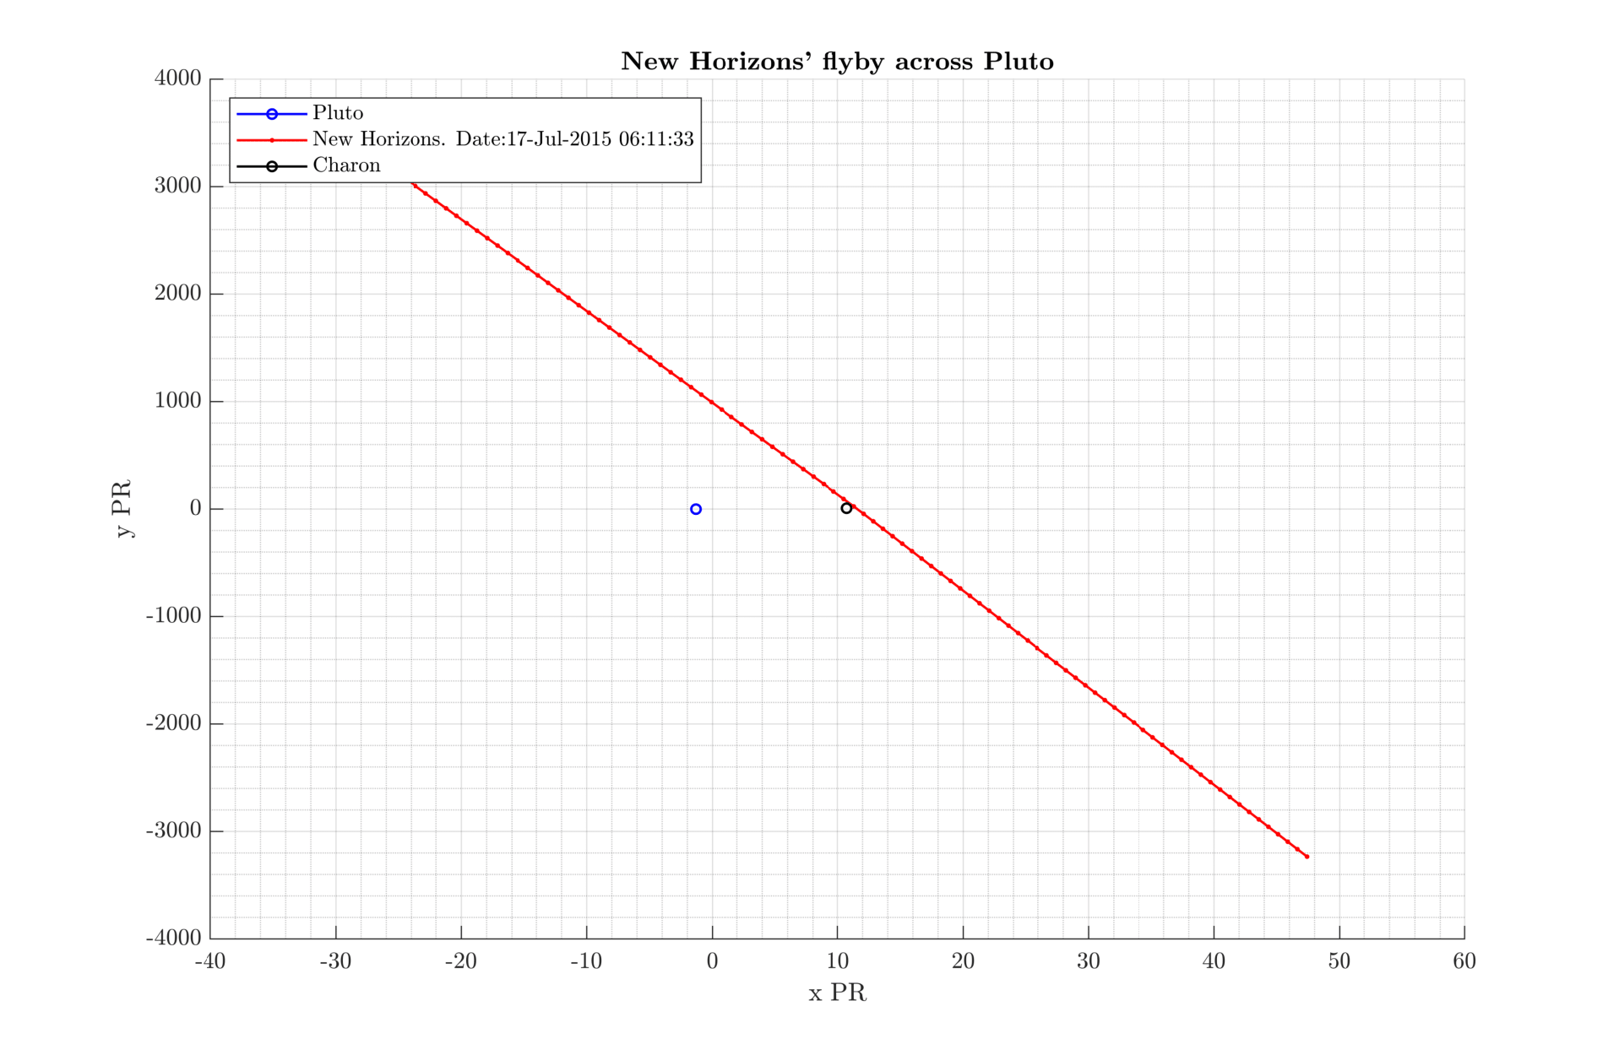

Slide 12
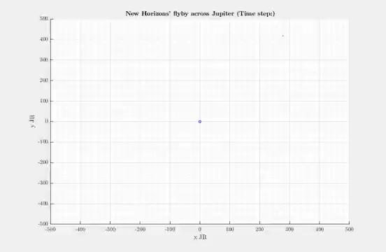
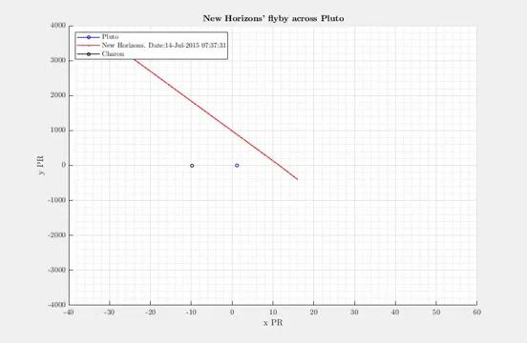

Slide 13
“Rediscover” Linda Morabito’s volcanic plume on Io
A3 - Image Processing Assignment

Slide 14
A3 - Image Processing Workflow to reveal the plume
GEOMED image in binari format
Convert image into a suitable format with VICARREAD5
Convert uint16 into double format
1-Improve contrast
2-Increase local brighten
Provoke small changes to avoid loss of detail and image burning.
3-Adjust local contrast
4-Increase exposure dark areas
Re-run until the result is acceptable
5-Adjust overall contrast
6-Sharpen small detail
7 Convert into uint16 and save

Slide 15
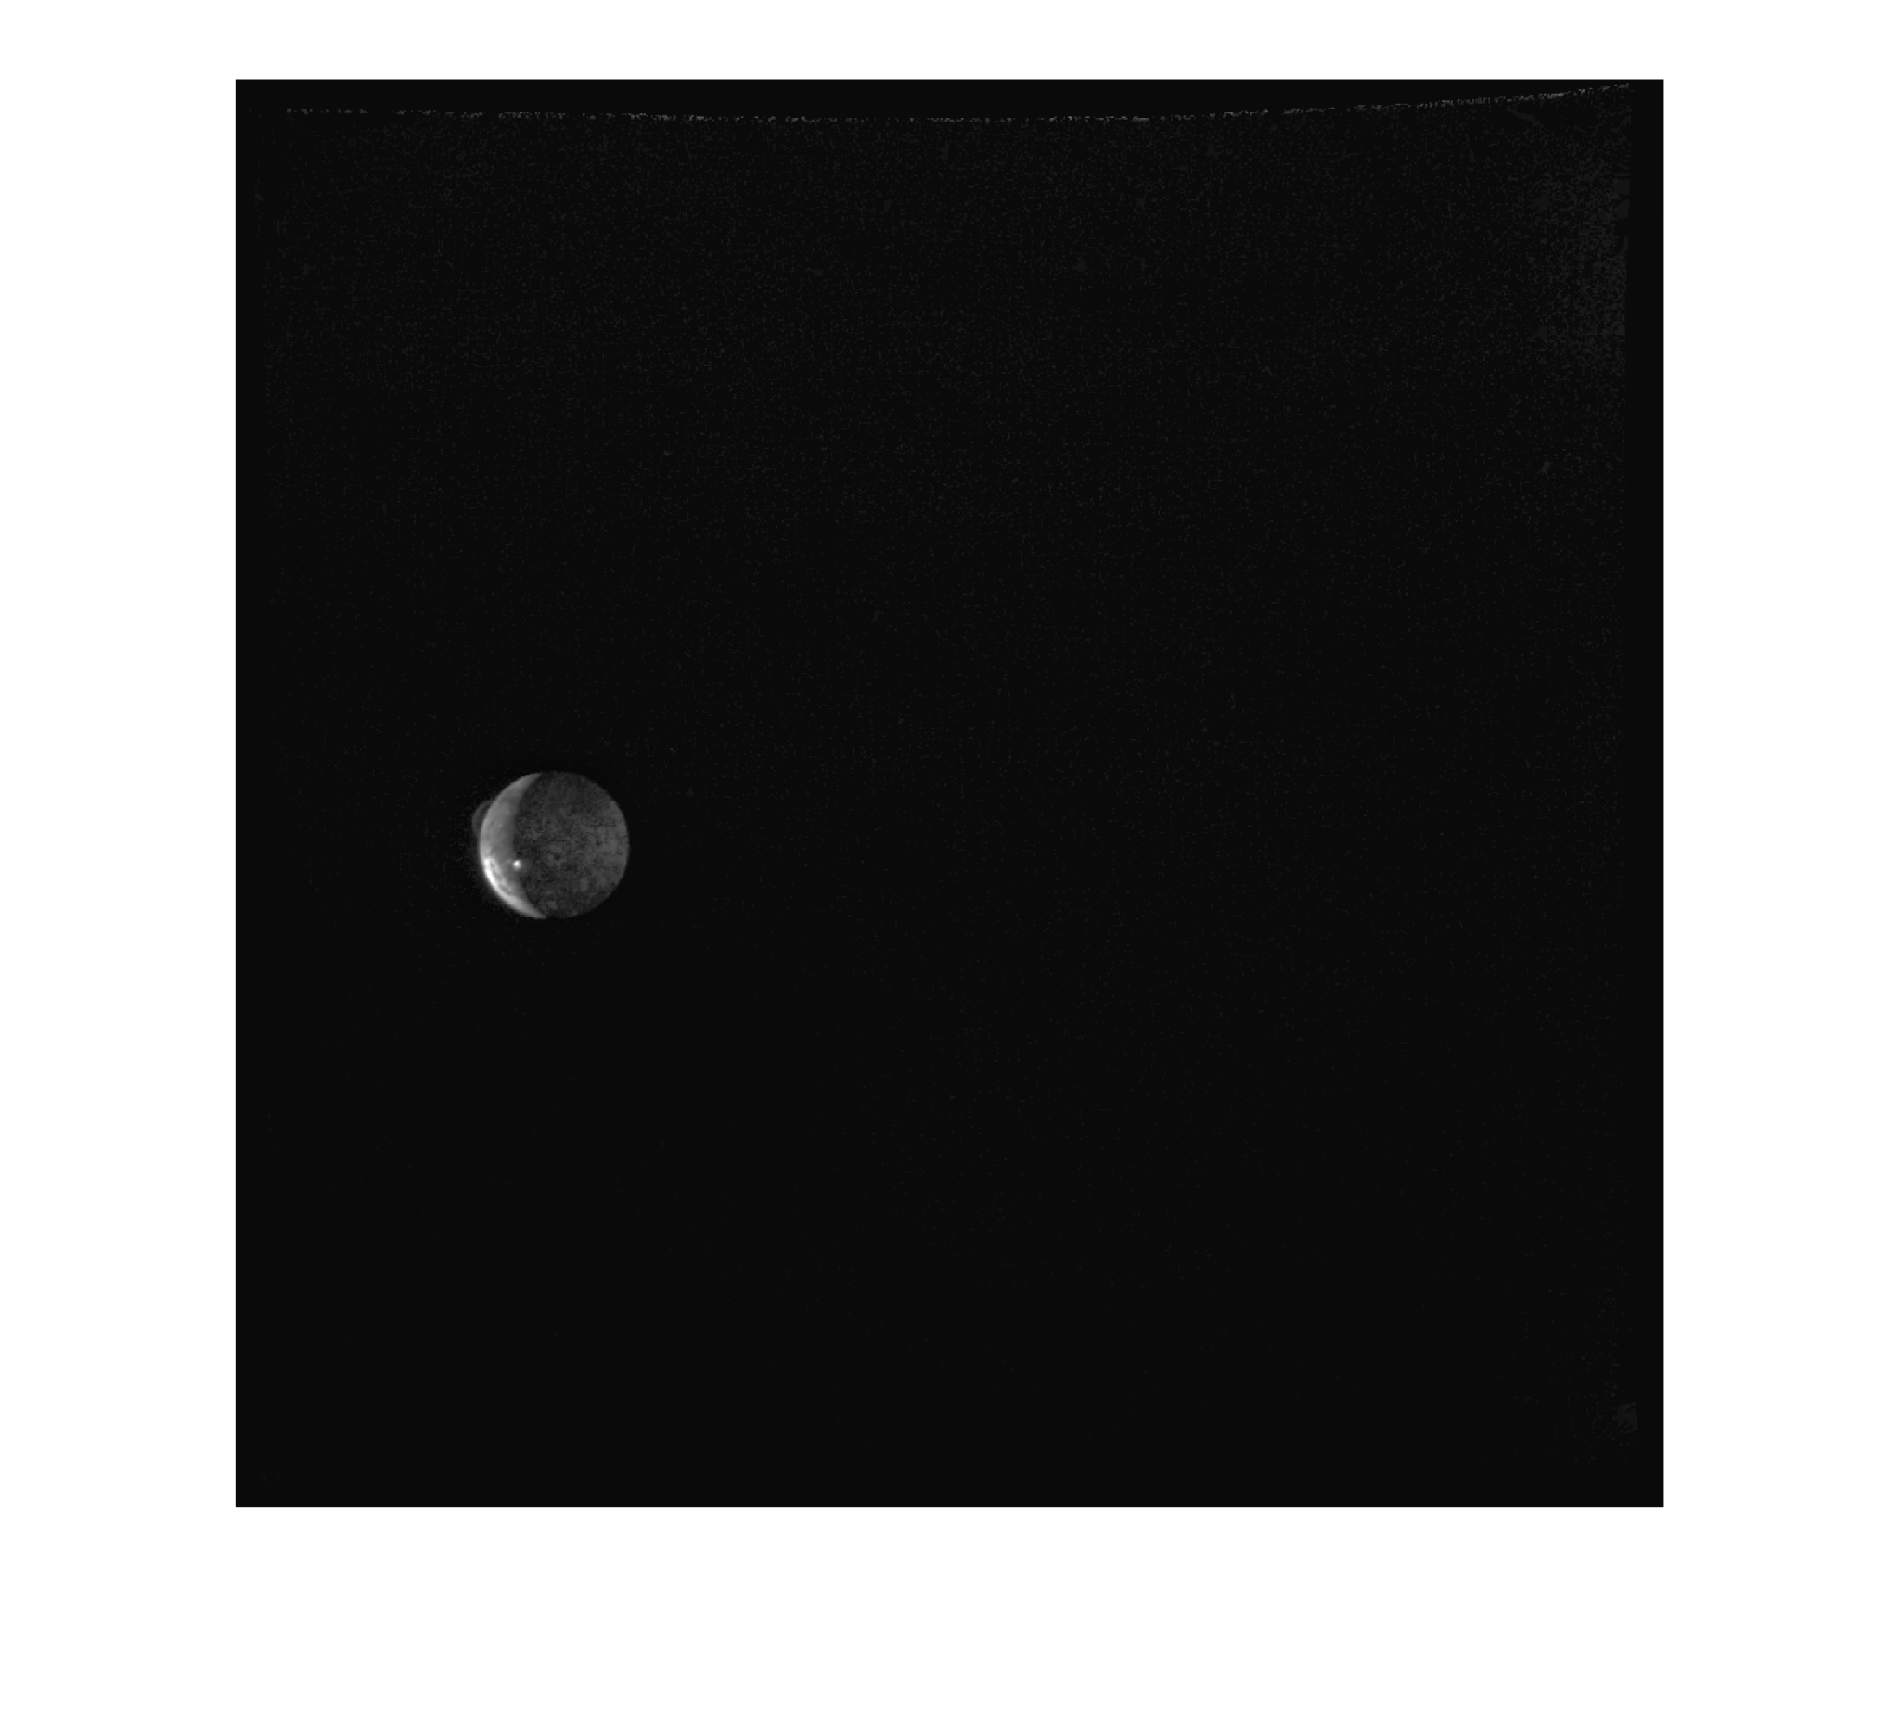
Io’s plume re-discovered

Slide 16
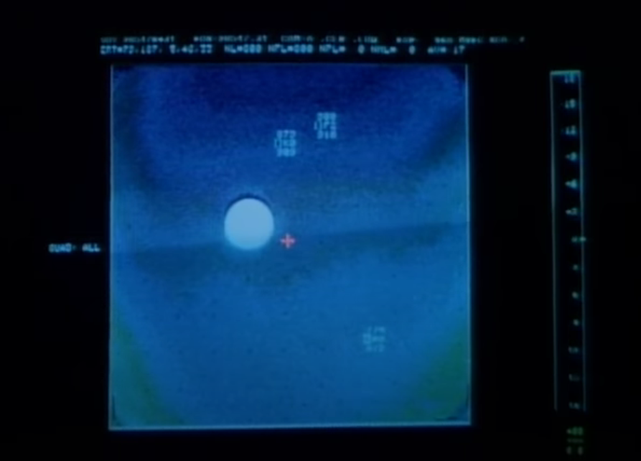
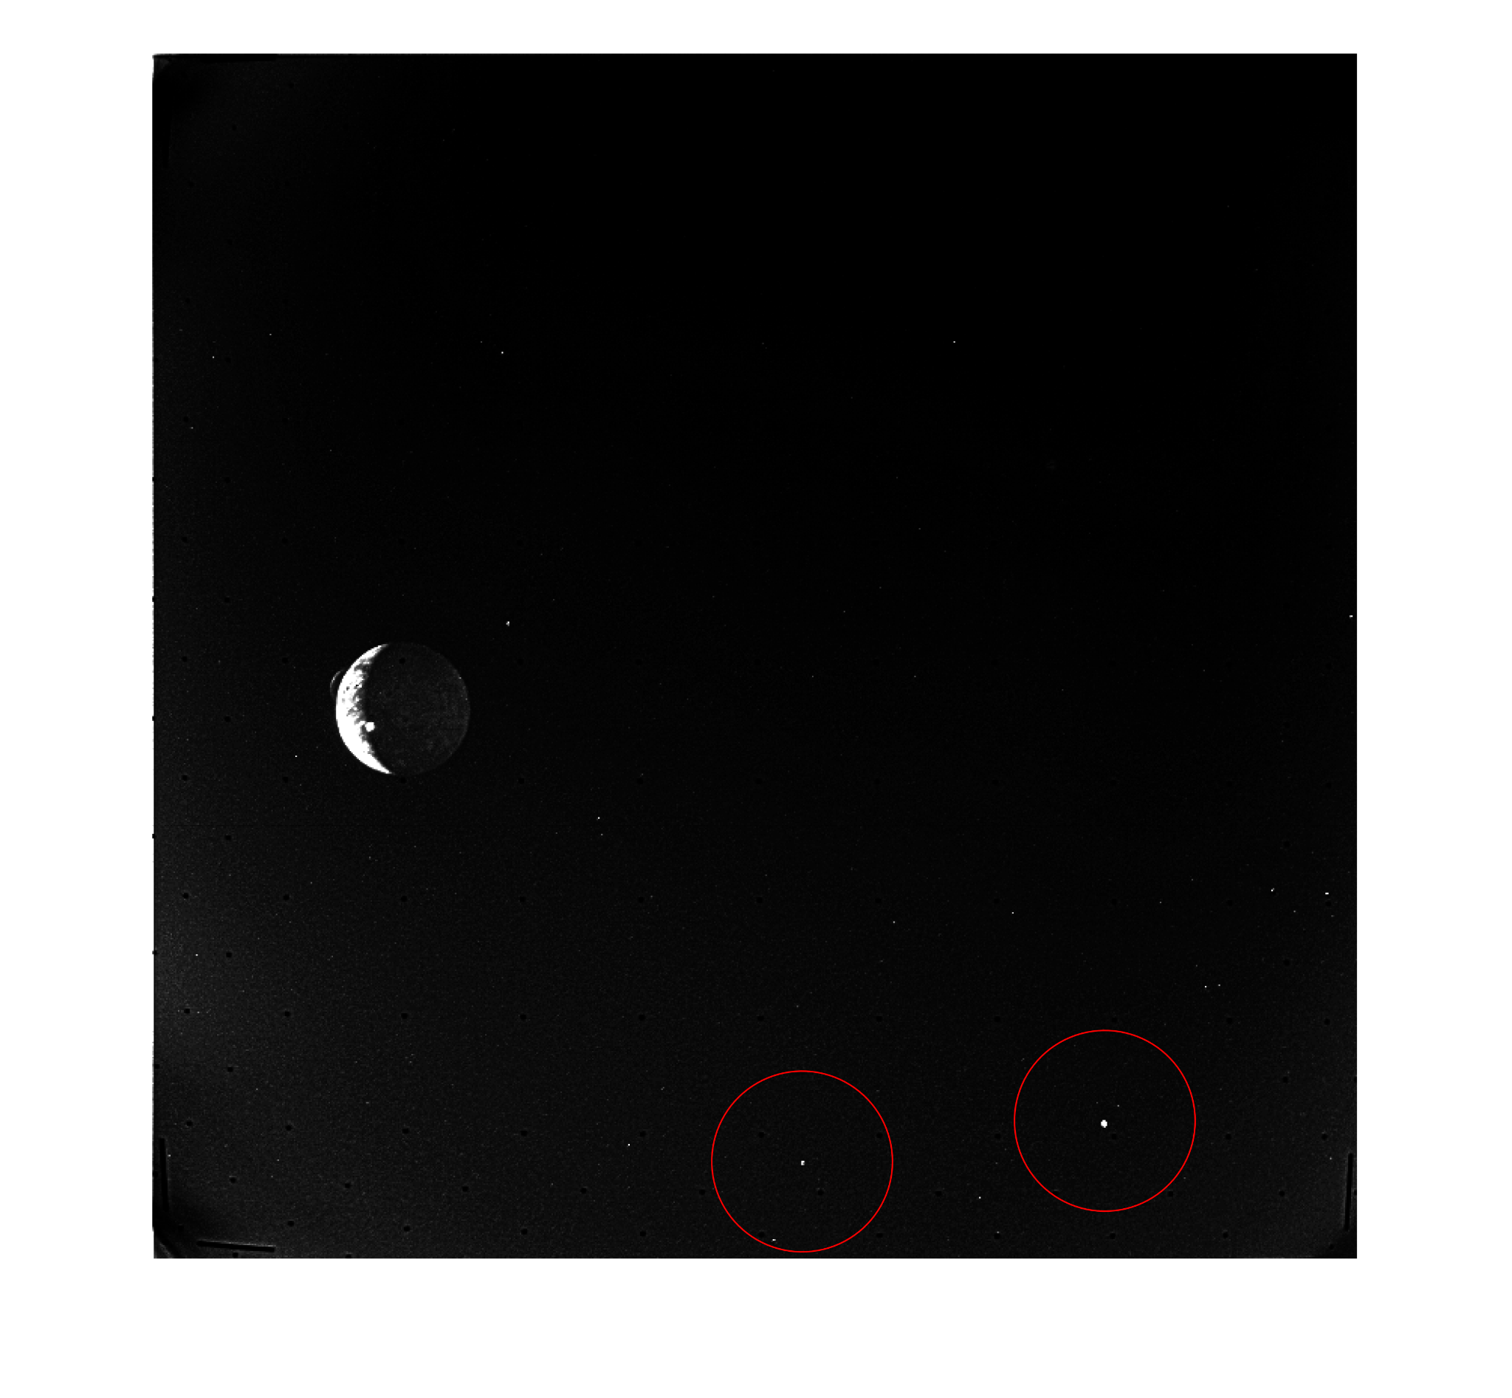
Can stars be identified?
Cases:
Video image is flipped and the upper located stars are the bottom stars in our image.
The image is not flipped and the lower star from the video is one of the marked points in our image
The points marked in our image are noise and do not correspond to any star.
Source: Carl Sagan' Cosmos

Slide 17
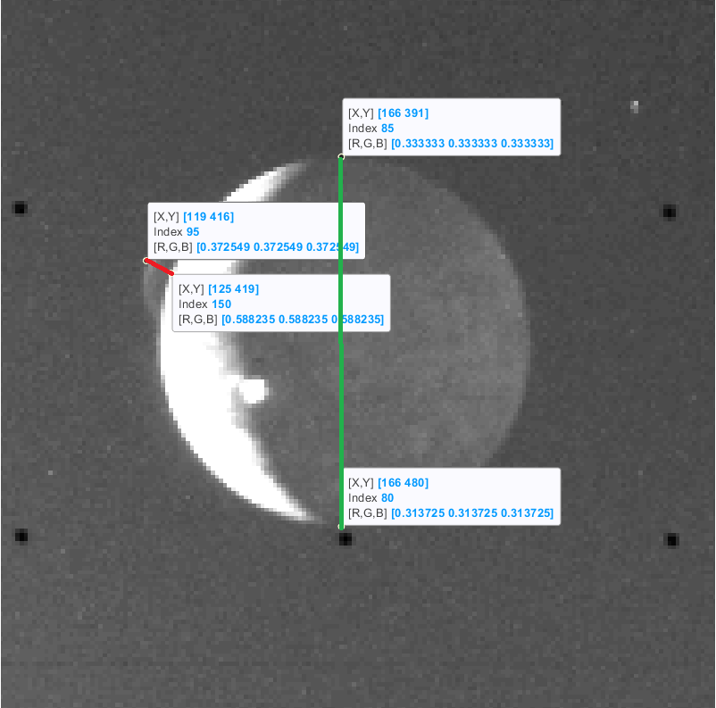
Plume elevation

Slide 18
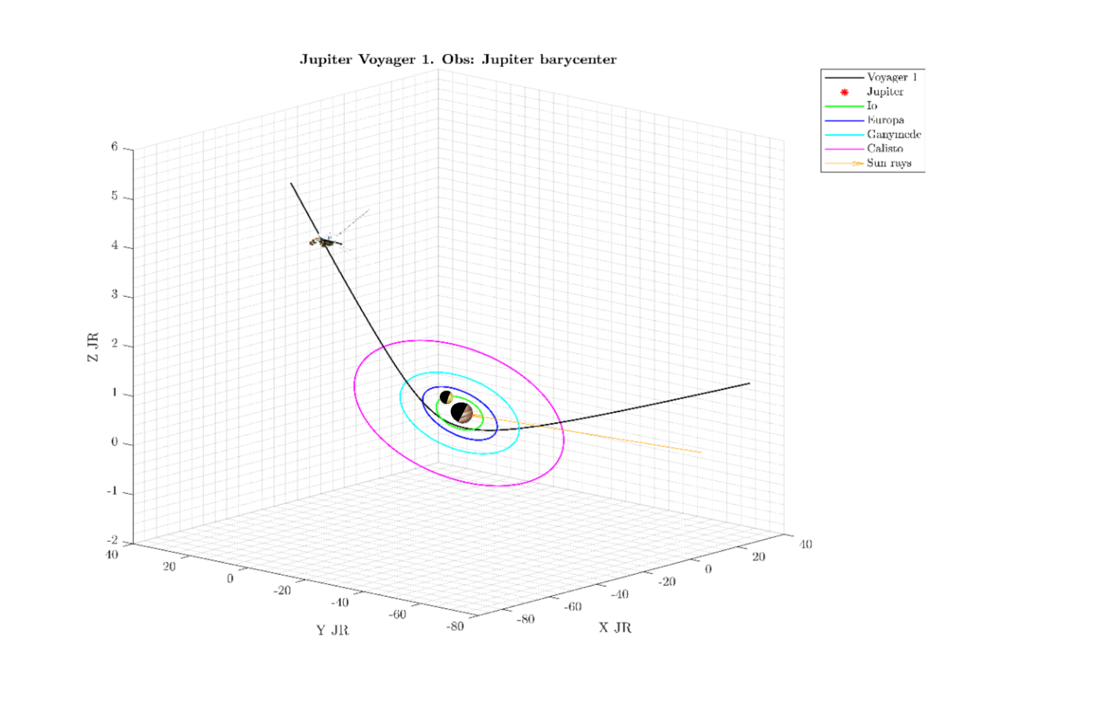
Overall situation

Slide 19
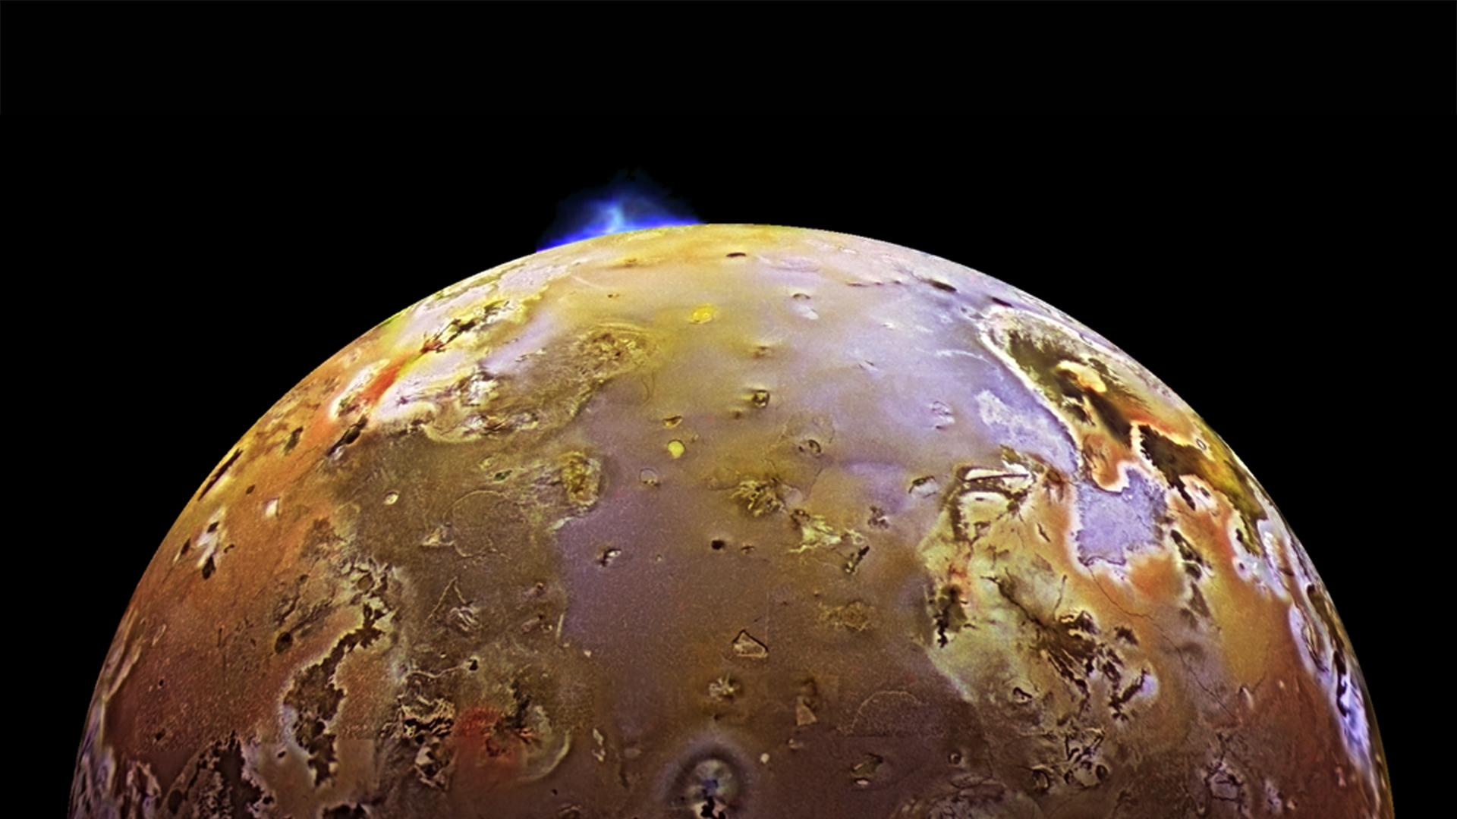
Image Processing Assignment
“It was the stuff of dreams, because I knew I was seeing something that most likely no human being had ever seen before.” Linda Morabito

Slide 20
“It was the stuff of dreams, because I knew I was seeing something that most likely no human being had ever seen before.” Linda Morabito

Slide 21
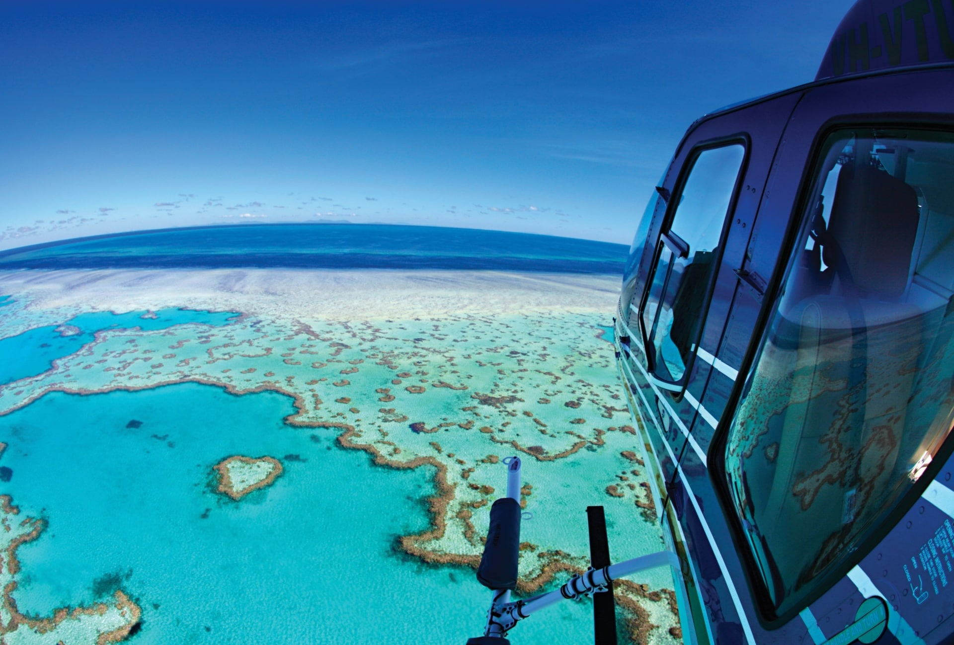
Remote Sensing of Earth Project
“Australia's Great Barrier Reef has lost more than half of its corals since 1995 due to warmer seas driven by climate change, a study has found.”

Slide 22
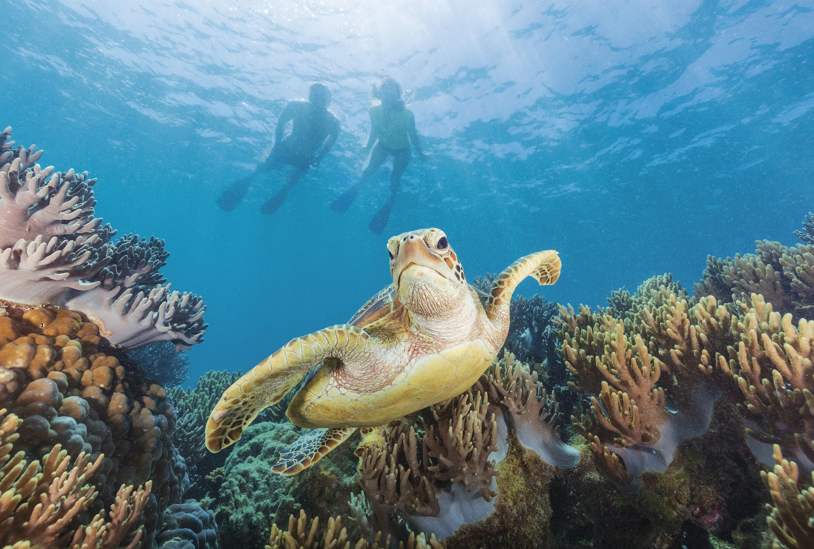
Reasons of Interest
World’s largest living structure and, in fact, it is so large that it can be seen from space.
Home for a massive amount of species.

Slide 23
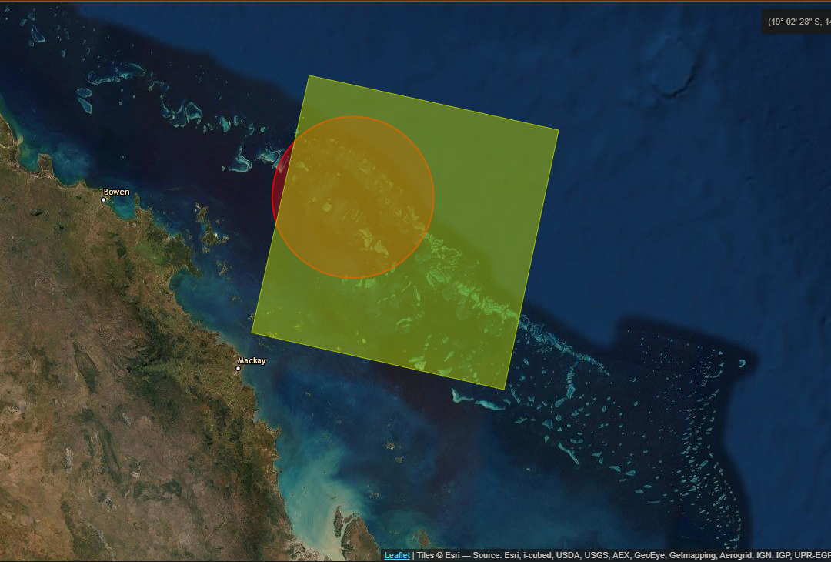
Problem Definition
Understand what is really happening with these corals by analysing temperature and chlorophyll in Summer and Winter of the years 2005, 2010, 2015 and 2020.

Slide 24
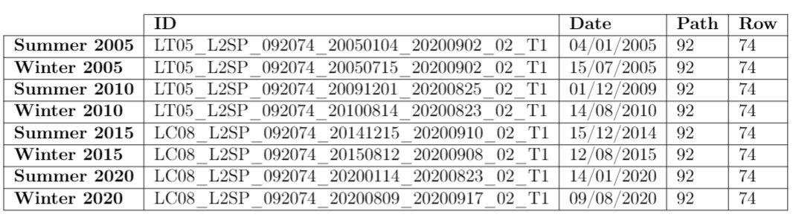
Data Source
Details about the data used in our project, including the path, row, date and ID for each year and season.

Slide 25
Natural Colour
False Colour
Natural colour composite is an image displaying a combination of the visible red, green and blue bands to the corresponding red, green and blue channels on the computer display.
The resulting composite resembles what would be observed naturally by the human eye: vegetation appears green, water dark is blue to black and bare ground and impervious surfaces appear light gray and brown.
False colour images are a representation of a multispectral image produced using any bands other than visible red, green and blue as the red, green and blue components of the display.
False colour composites allow us to visualize wavelengths that the human eye can not see
Bands 4, 3 and 2 for both Landsat 5 (2005) and Landsat 8 (2020)
Bands 5,4 and 3 for Landsat 5 (2005) and Band 654 for Landsat 8 (2020)

Slide 26
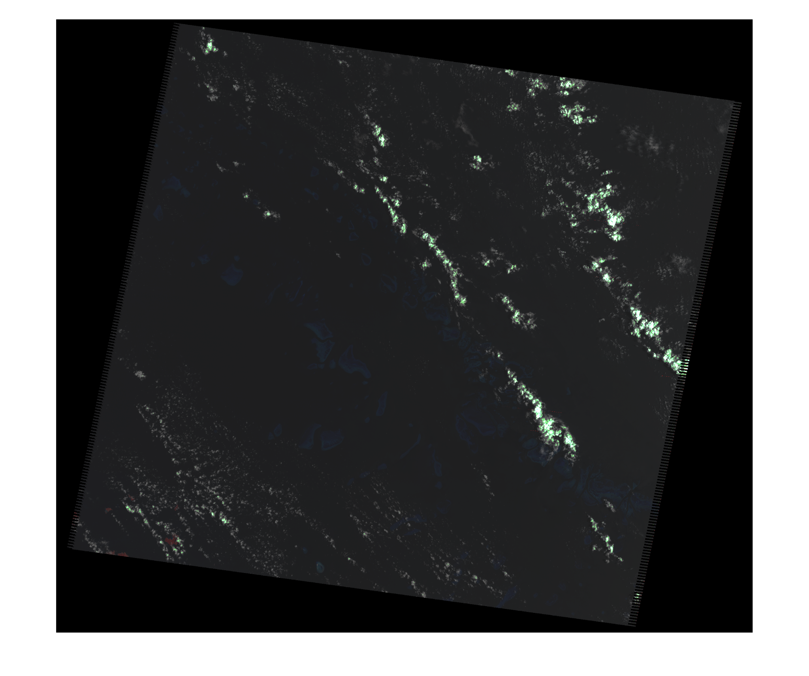
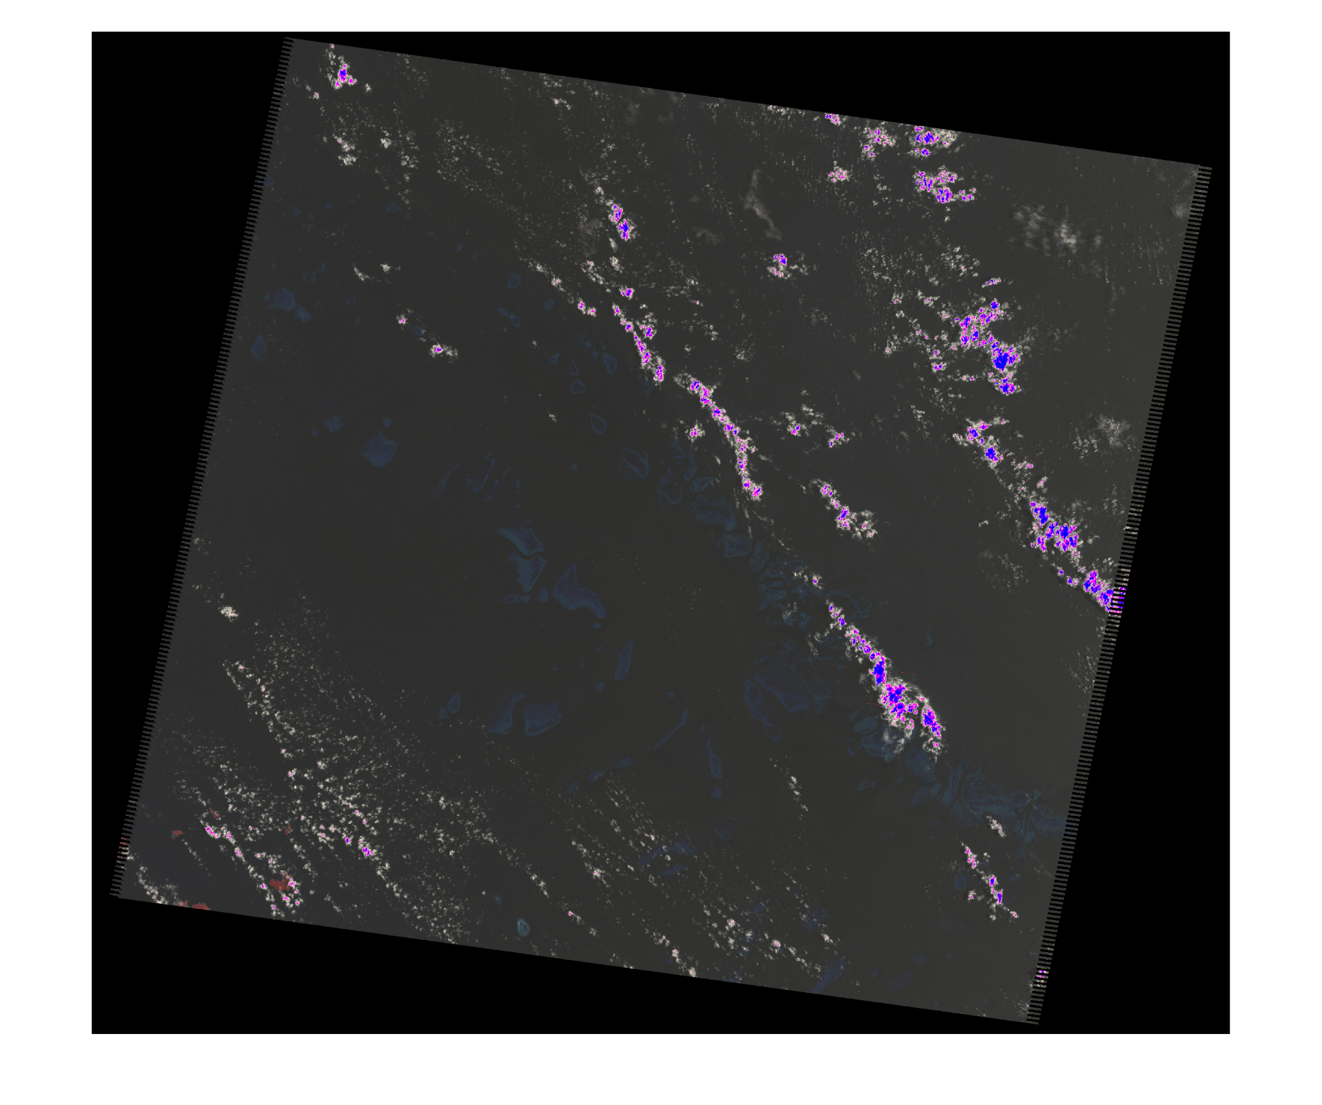
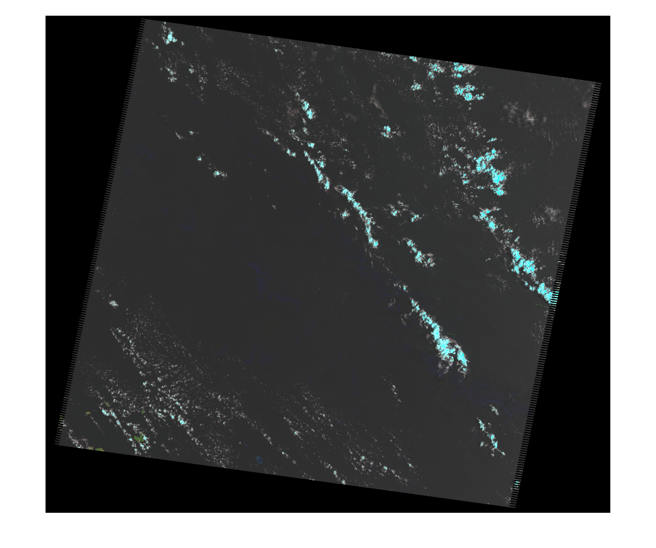
Summer 2005
Original
Natural colour
False Colour

Slide 27
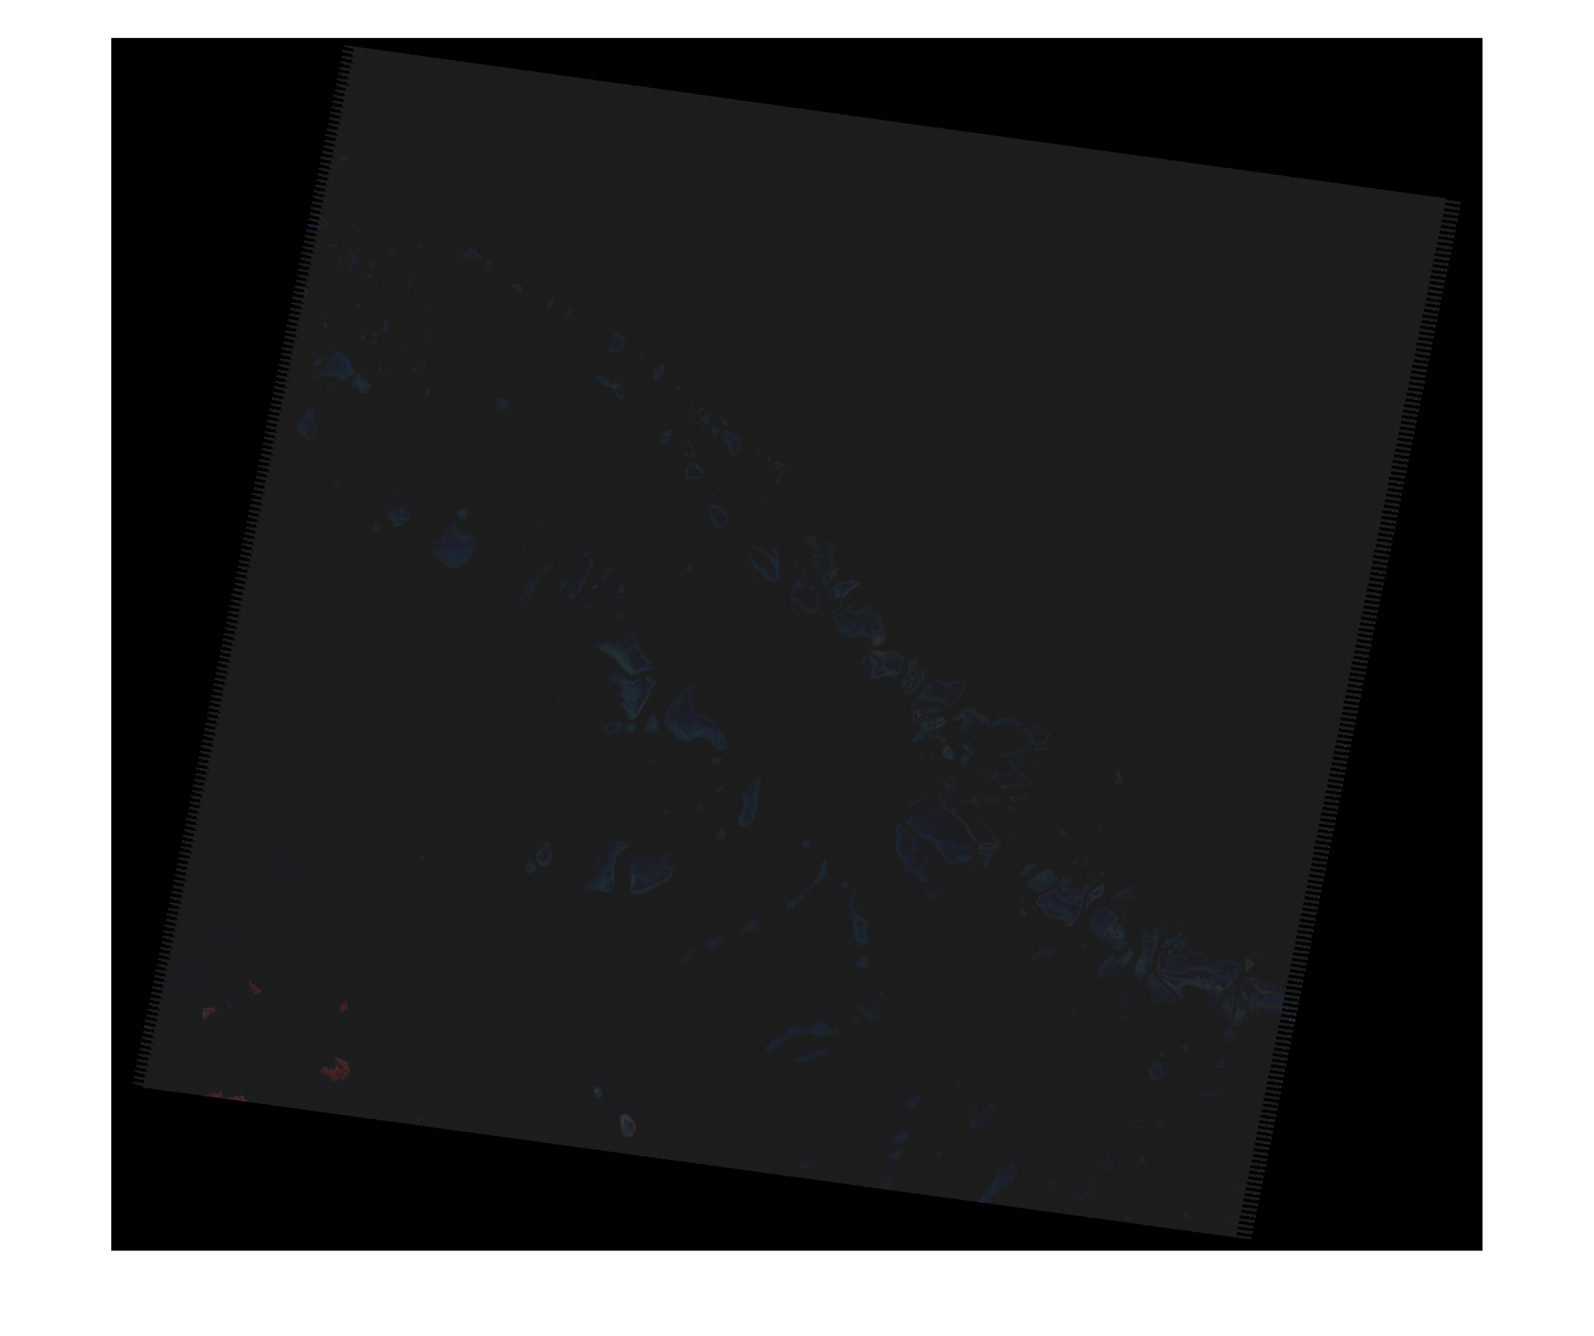
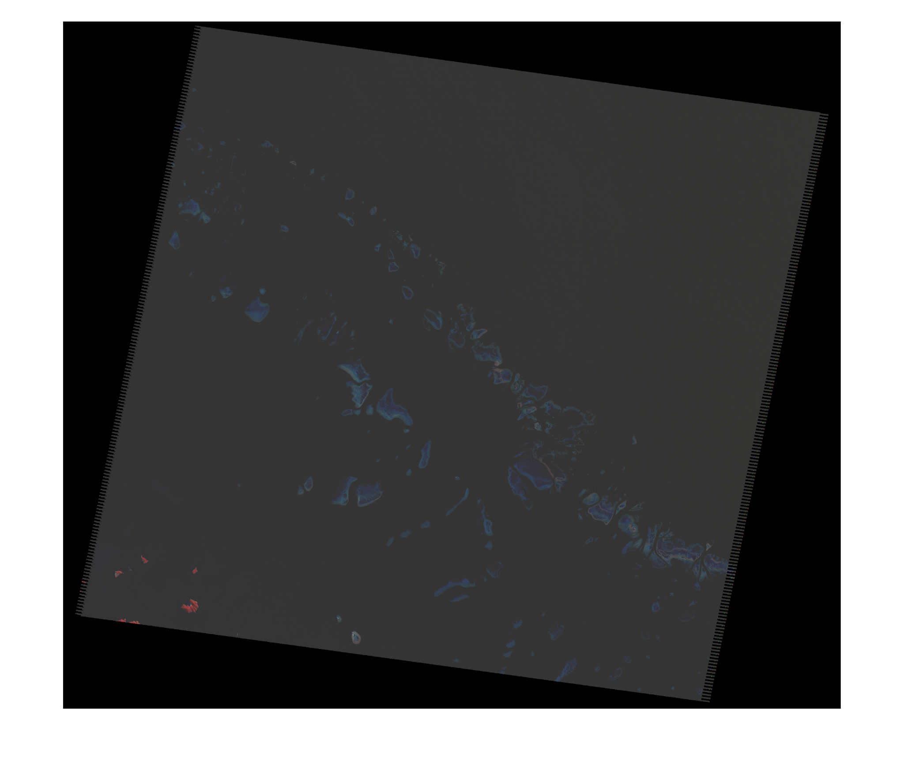
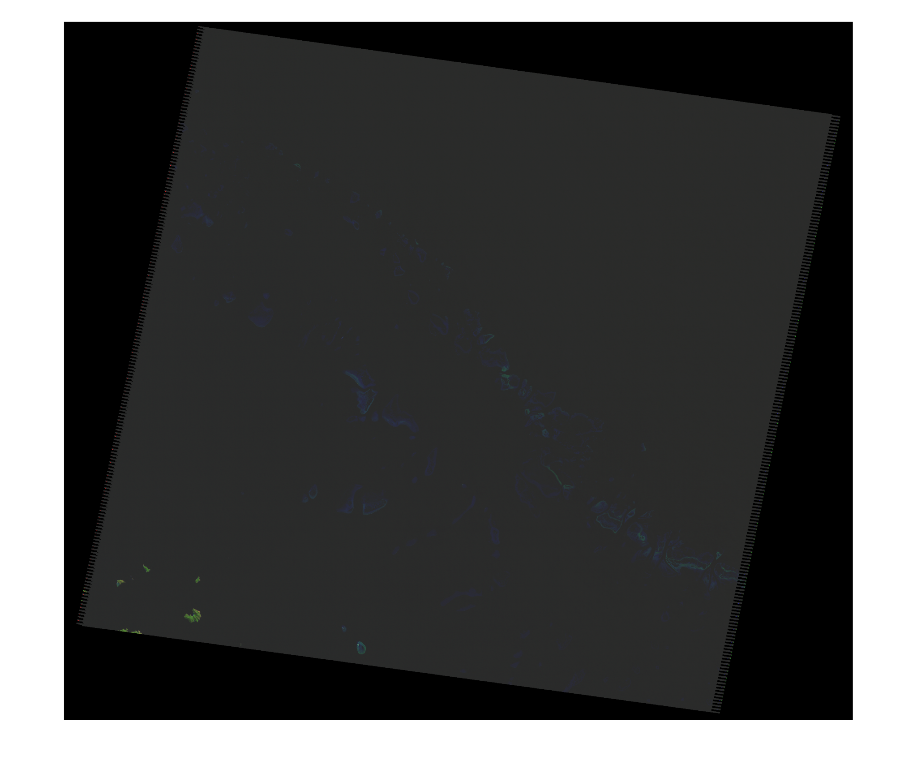
Winter 2005
Original
Natural colour
False Colour

Slide 28
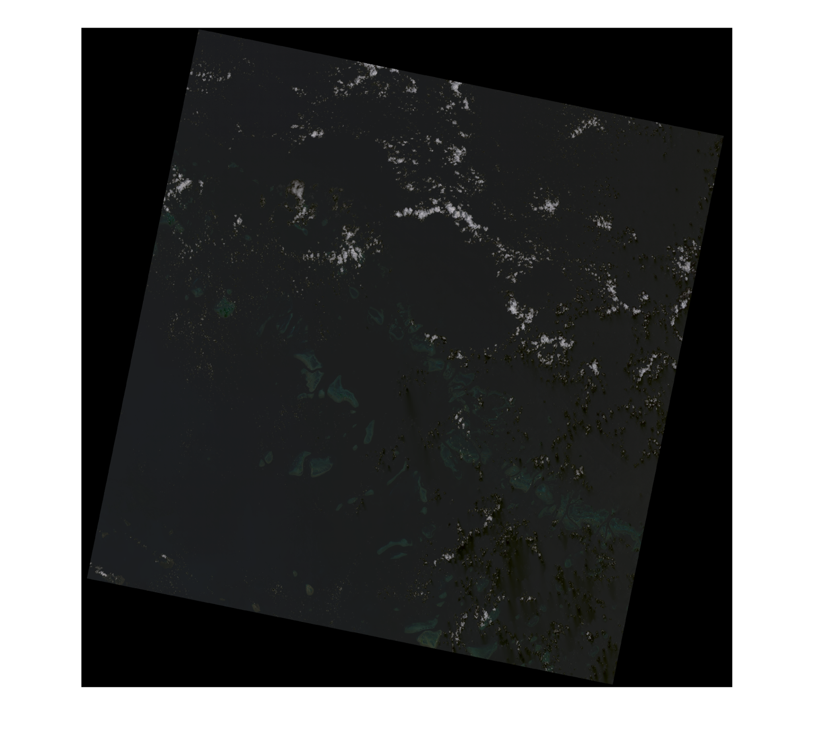
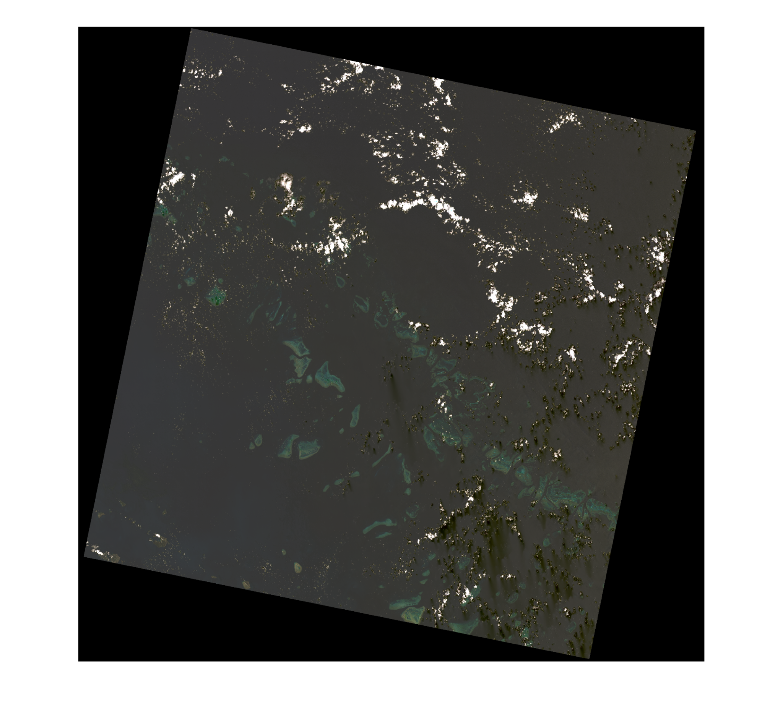
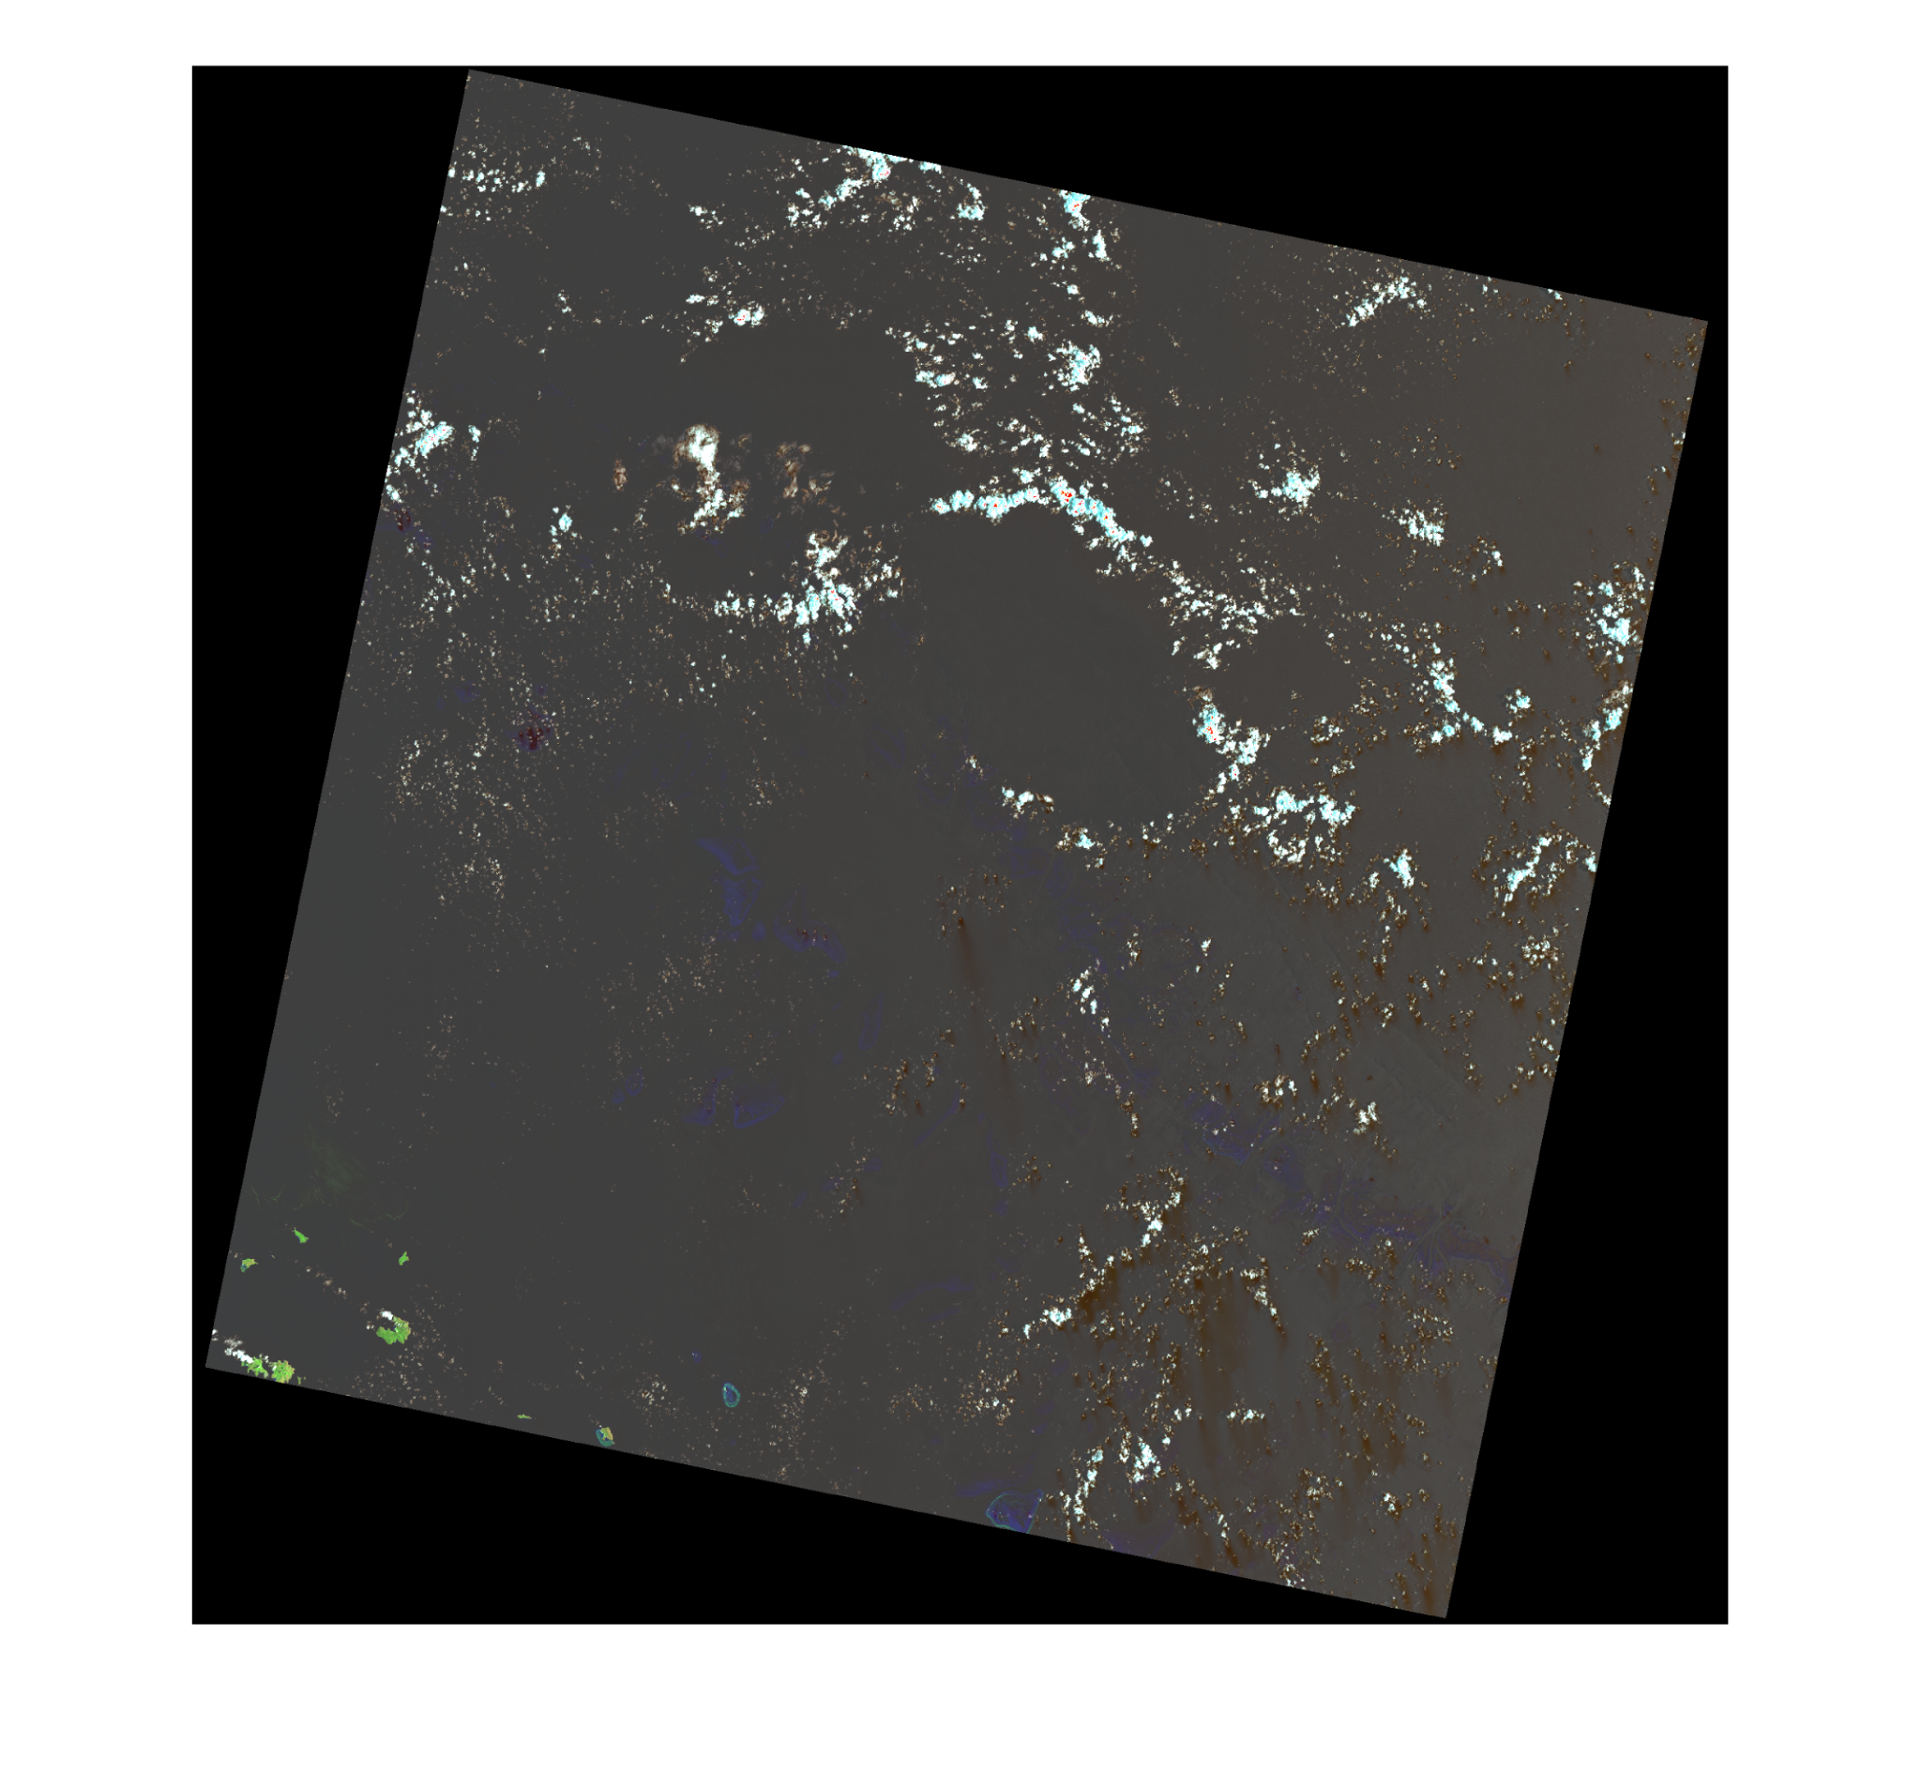
Summer 2020
Original
Natural colour
False Colour

Slide 29
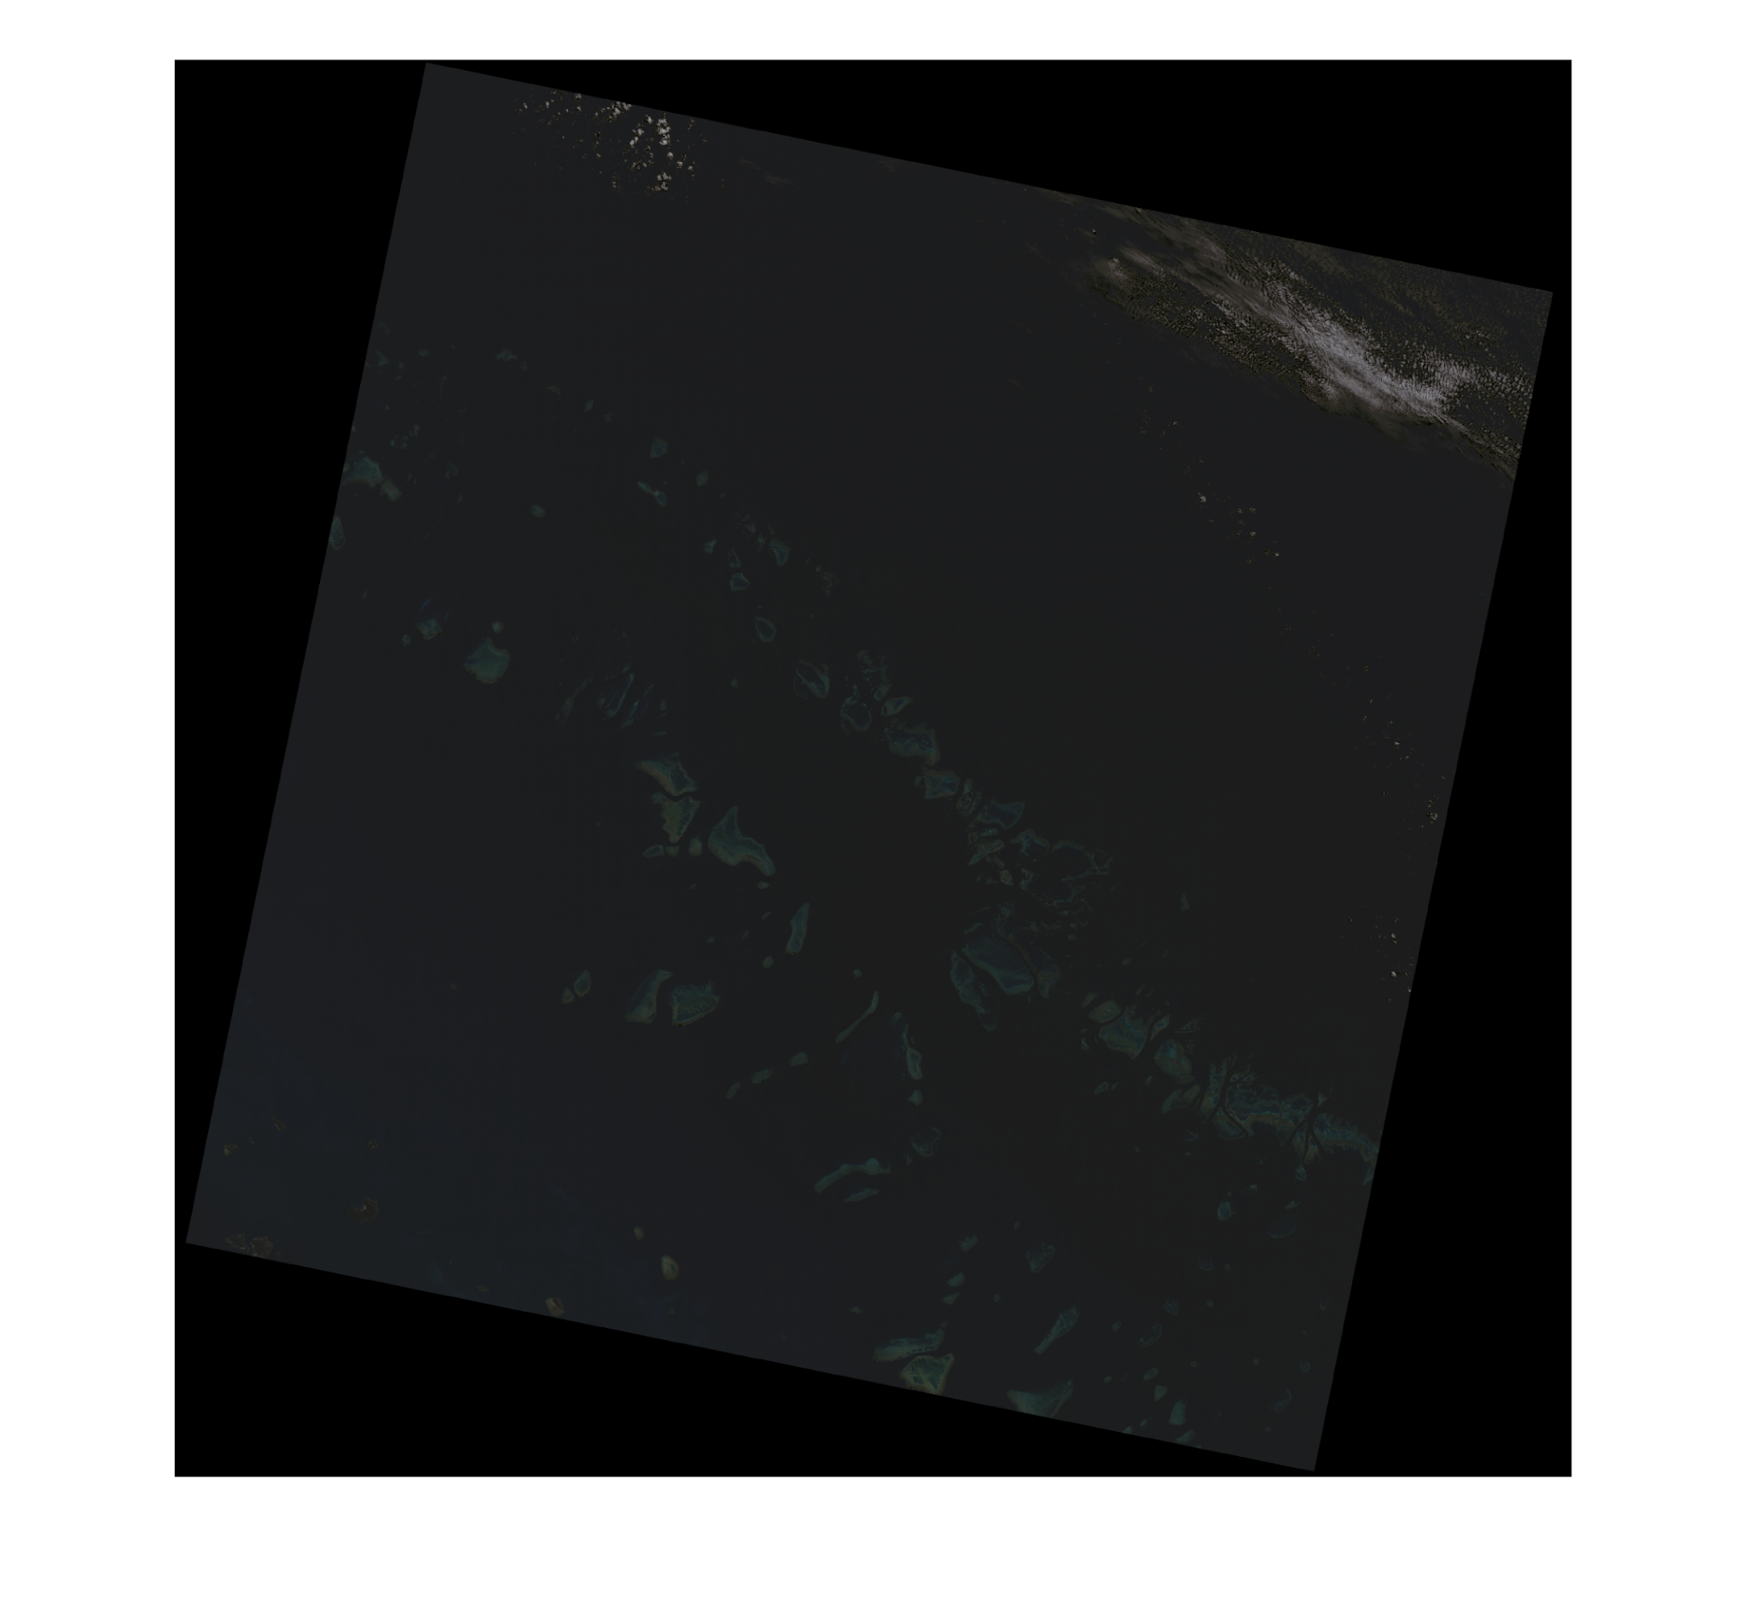
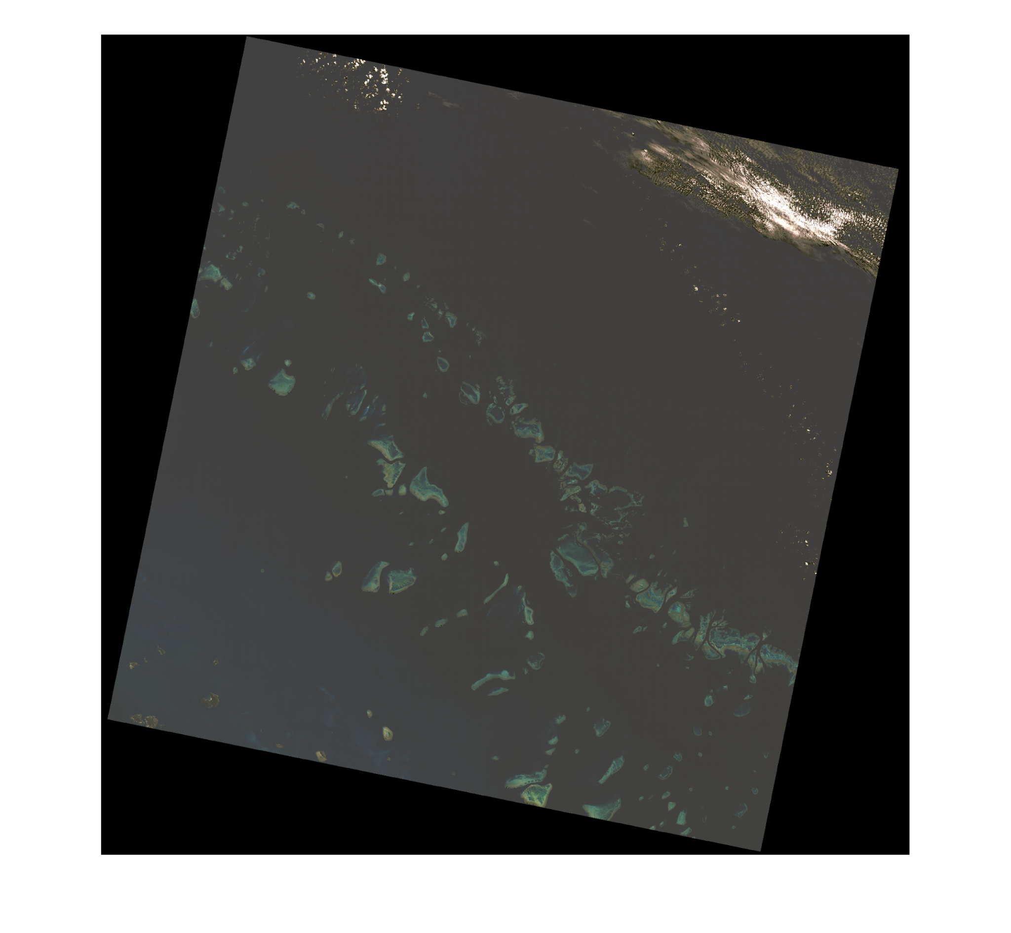
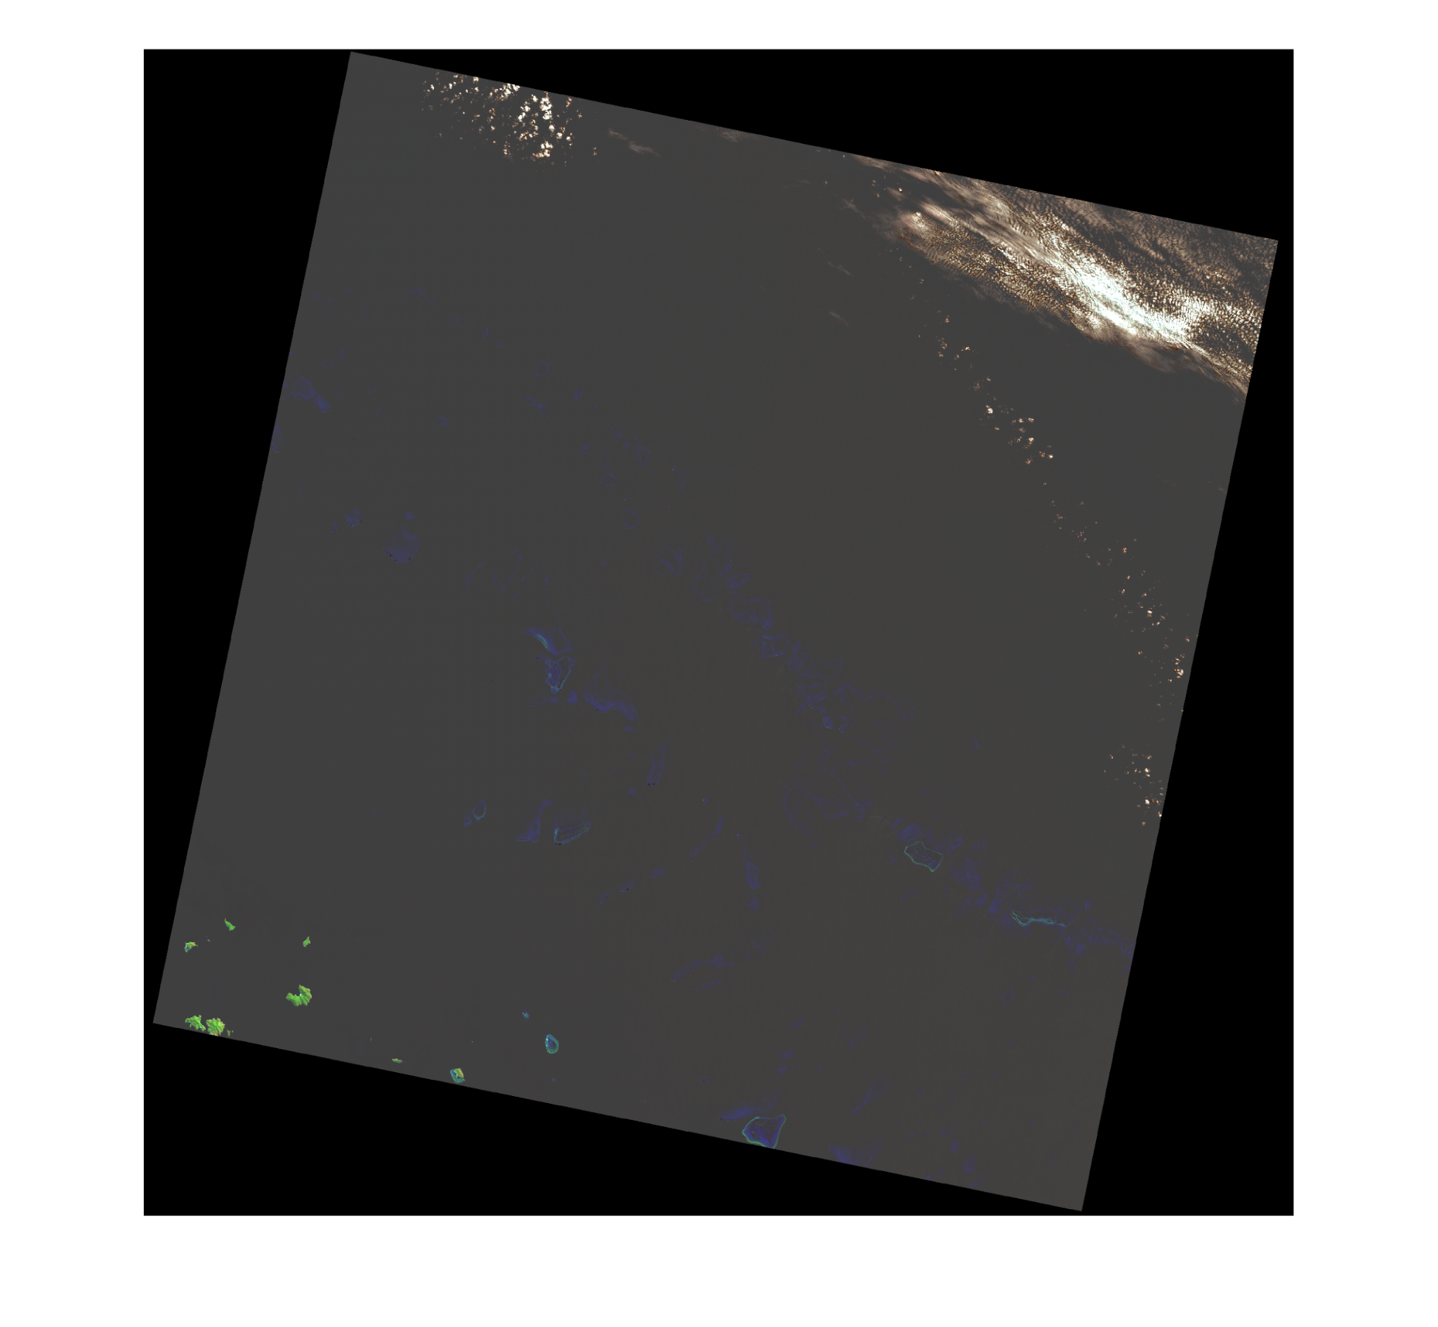
Winter 2020
Original
Natural colour
False Colour

Slide 30
Temperature
Chlorophyll
Band 6 for Landsat 5 (2005 and 2010) and Band 10 for Landsat 8 (2015 and 2020)
Bands 1,2, 3 and QA for Landsat 5 (2005 and 2010) and for Landsat 8 (2015 and 2020)

Slide 31
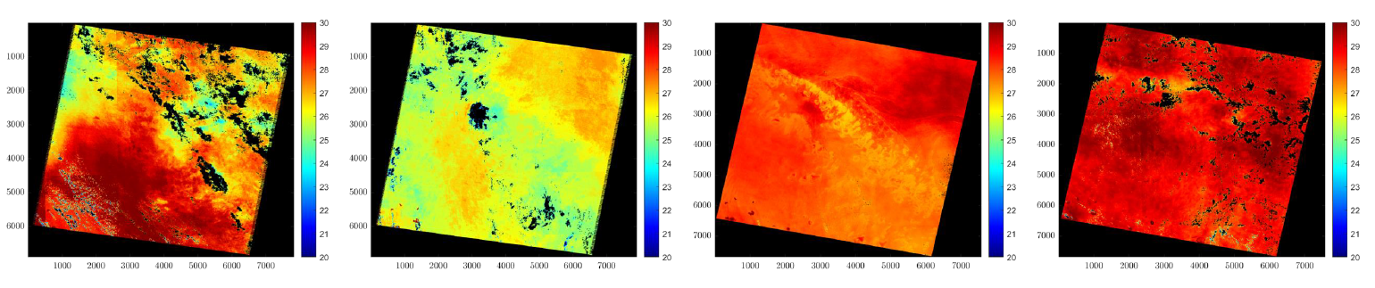
Temperature (Summer)
2005 to 2010: sharp drop on the temperature La Nina Phenomenon
2010 to 2015: sharp rise in the temperature El Nino Phenomenon
2005
2010
2015
2020

Slide 32
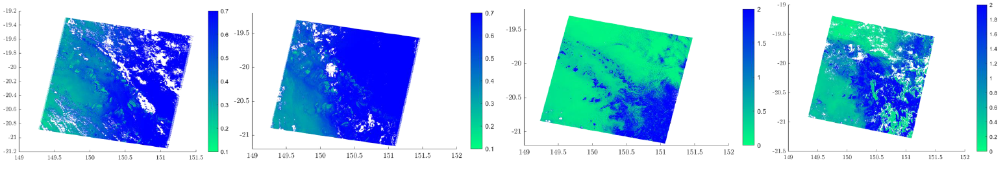
Chlorophyll (Summer)
Coral bleaching happens when the corals are stressed by changes in conditions such as temperature, light or nutrients.
La Nina and El Nino phenomenon one after another lead to Coral Bleaching in 2010.
In 2015 and 2020 higher concentrations of chlorophyll.
2005
2010
2015
2020

Slide 33
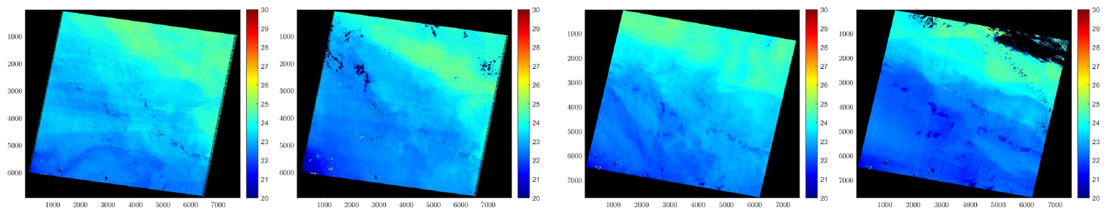
Temperature (Winter)
Summer to Winter there is a sharp drop of temperature of approximately 5º which is normal.
no very marked differences from year to year
2005
2010
2015
2020

Slide 34
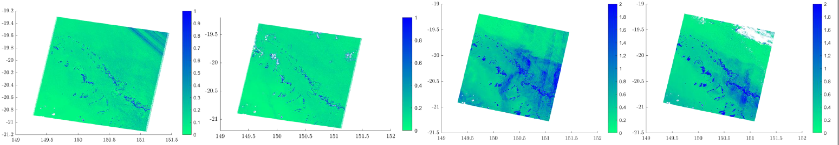
Chlorophyll (Winter)
No major differences from 2005 to 2010 and the corals have the highest concentration comparing to the surroundings.
Higher concentrations of chlorophyll in 2015 and 2020 (as seen in the summer).
2005
2010
2015
2020

Slide 35
“Our Reef is still beautiful but we need urgent action on climate change to give it the best chance for the future. ”

Slide 36
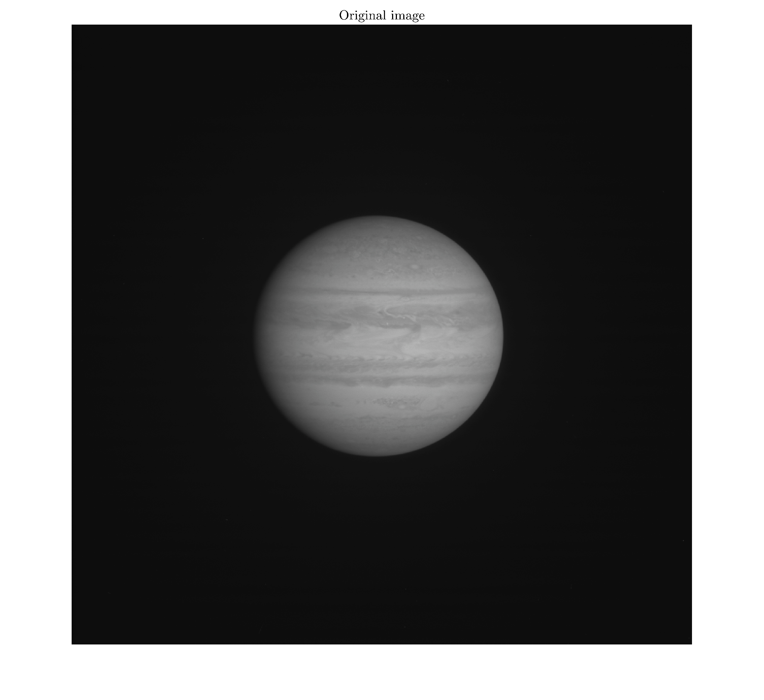
Original image of Jupiter. Cassini 2000 - 10 - 01

Slide 37
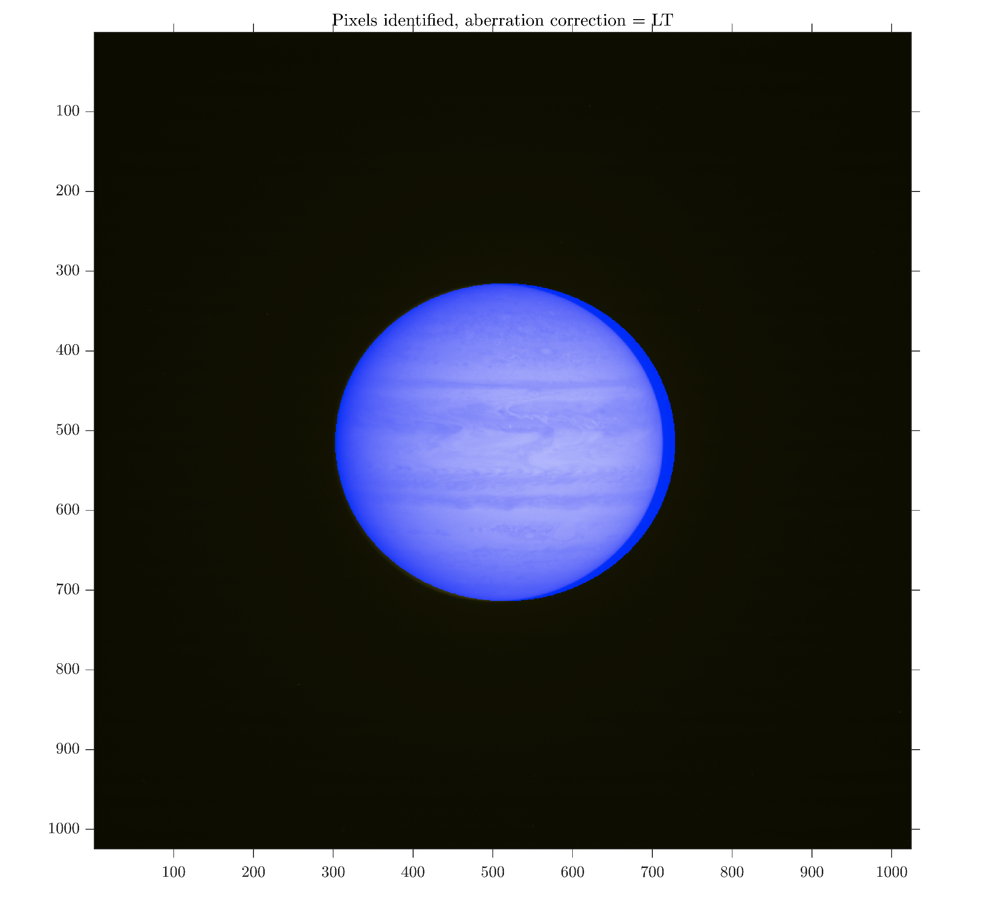
Theoretical position of Jupiter. Cassini 2000 - 10 - 01
Pixels outside Jupiter:
Black
Pixels inside Jupiter:
Blue

Slide 38
References
https://www.bbc.com/news/world-australia-54533971#:~:text=Australia's%20Great%20Barrier%20Reef%20has,events%20in%202016%20and%202017.
https://www.marineconservation.org.au/fight-for-our-reef/
https://www.skyatnightmagazine.com/space-missions/volcano-jupiter-moon-io-interview-voyager-linda-morabito/
Carl Sagan.Carl Sagan’s Cosmos: Episode 6-Travellers’ Tales.url: https://www.youtube.com/watch?v=EbljFJERflA&ab_channel=TomKNJ

